Slide 1
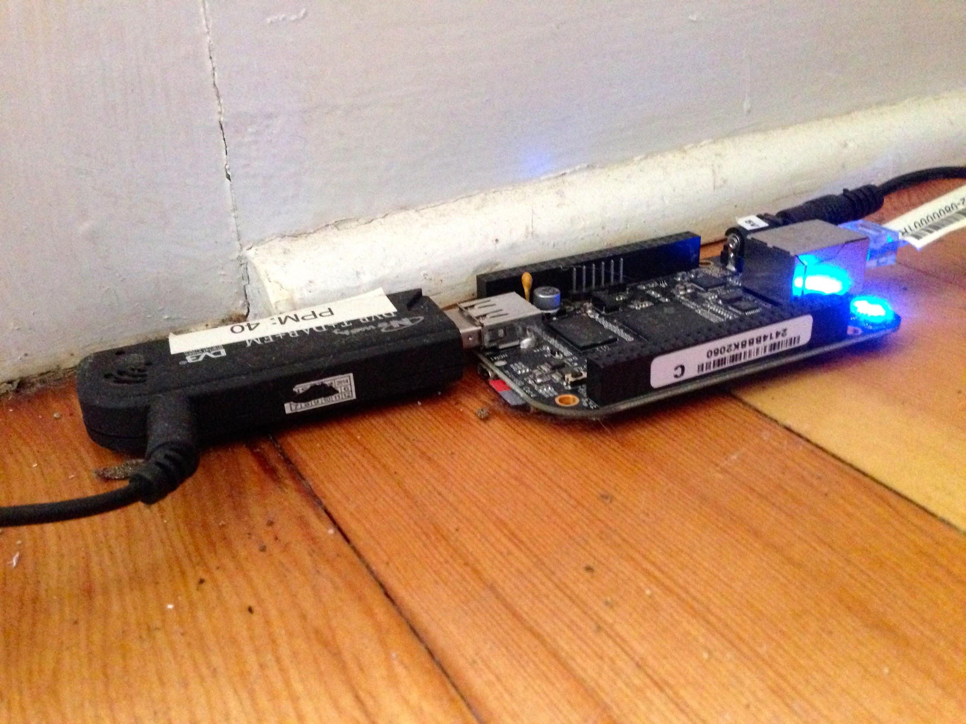
4414
Notes:
I’m calling this talk “4414” because that’s the most significant number in this story. 4414 is what really led to everything else. And this picture shows the crucial piece of hardware I used to do this: An RTL-SDR dongle and a BeagleBone Black.

Slide 2
Who am I?

Slide 3
John Wiseman
Disney R&D Imagineer
Interested in robotics, natural language processing, drones, aviation
@lemonodor
Notes:
The work I do at Disney has no overlap with this project :)

Slide 4
What is this about?

Slide 5
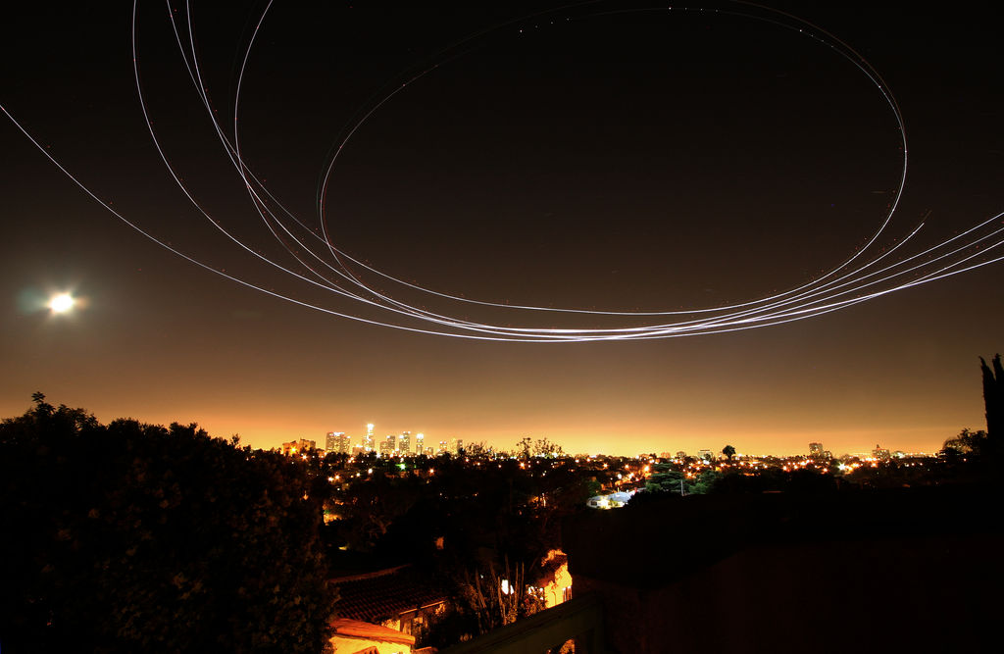
Tracking police helicopters
Notes:
The first year I lived in LA I had an experience with a police helicopter’s spotlight transfixing me from the heavens, which led to a long obsession. One thing I wanted to do was track them and learn their behaviors, like you might do with birds.

Slide 6
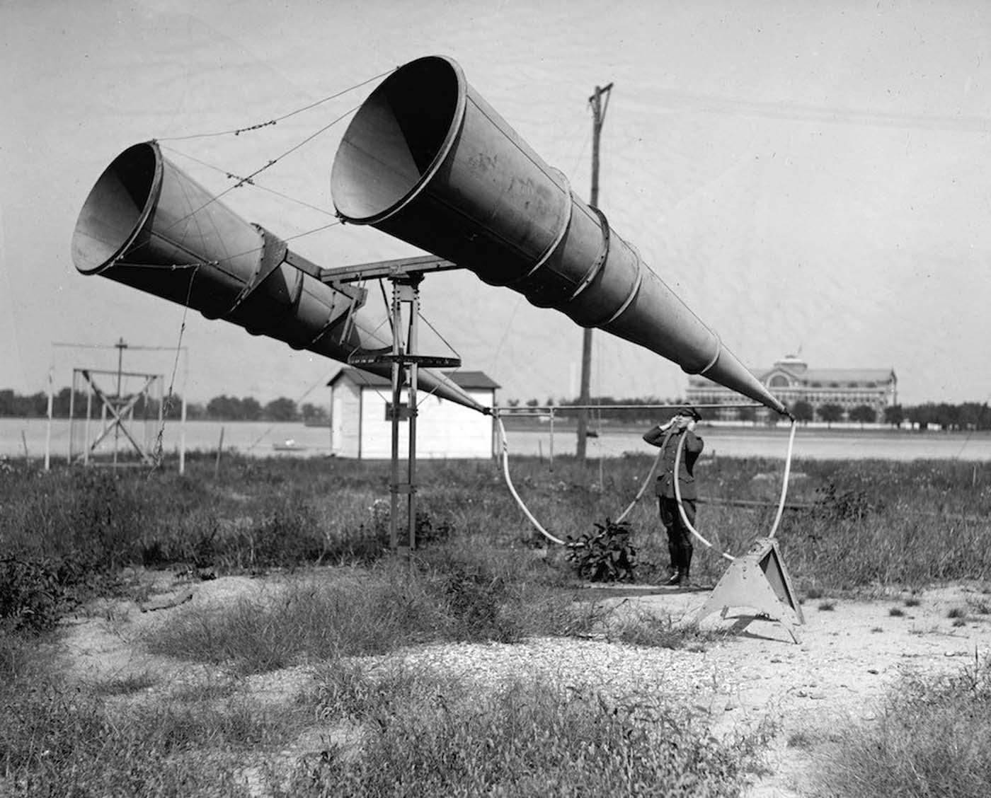
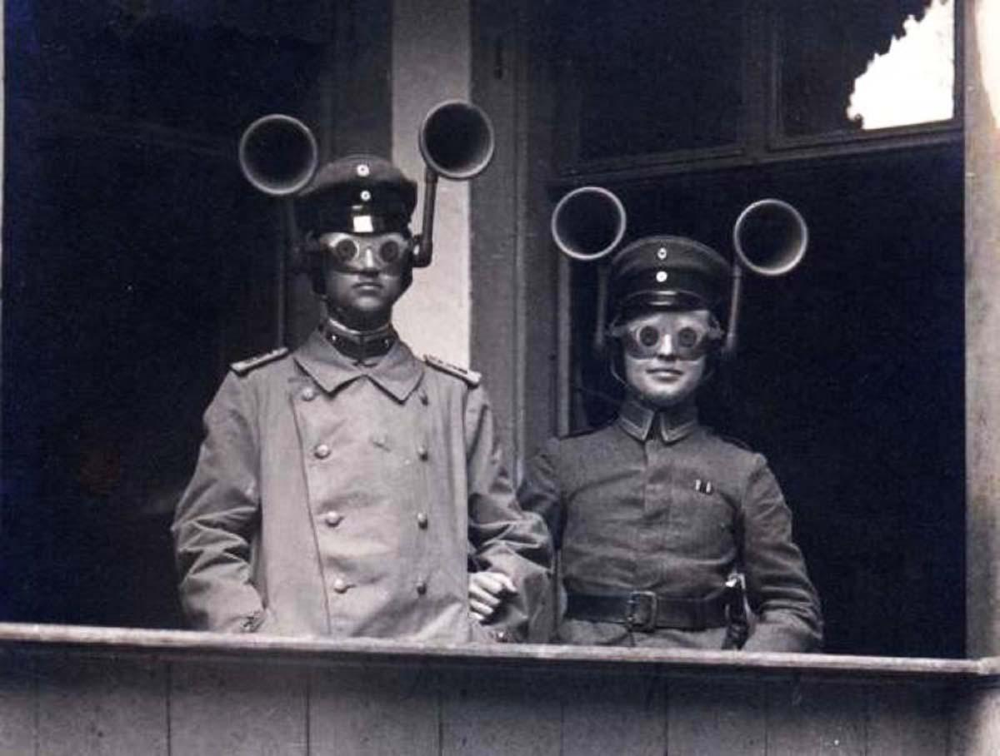
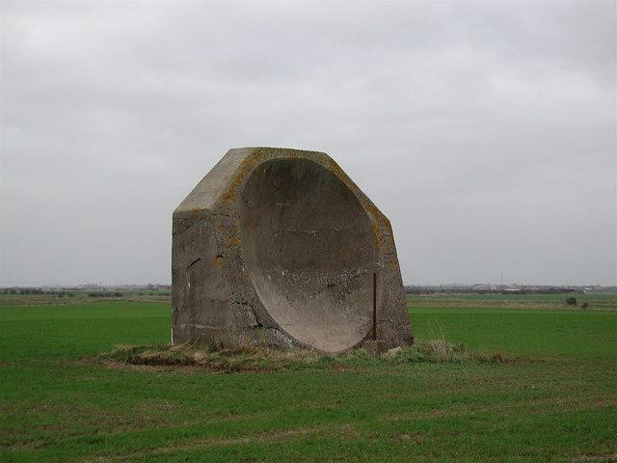
Notes:
I tried to come up with the easiest way to track helicopters, and spent a lot of time thinking about acoustic tracking, which has a long history.

Slide 7
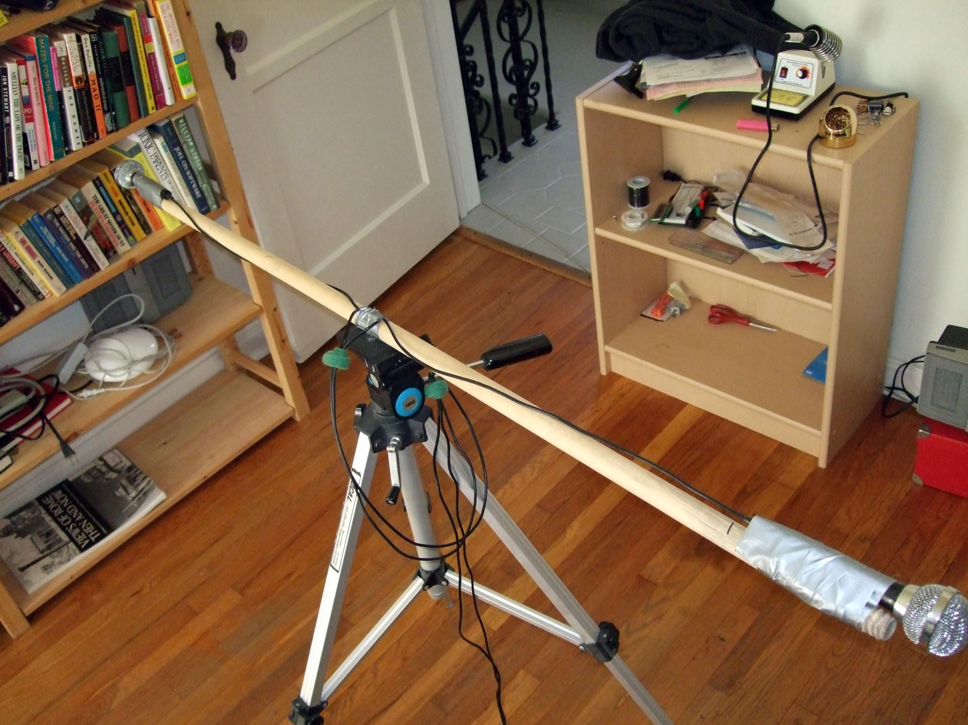
Notes:
But I never got it to work very well.

Slide 8
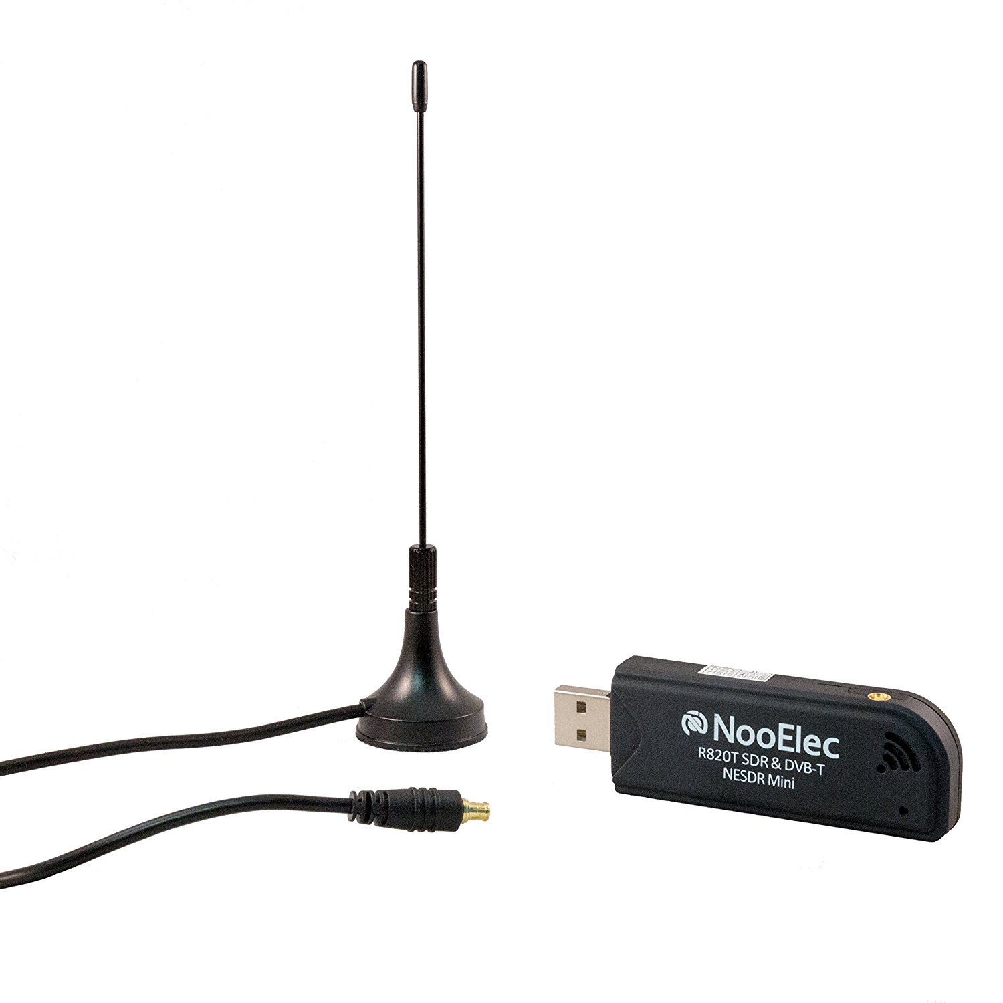
Notes:
But then this amazing thing happened: Someone figured out the RTL dongle for receiving digital TV transmissions could be used as a wideband SDR and pick up all sorts of stuff, including the aircraft transponder packets on 1090 MHz that sometimes include aircraft position.

Slide 9
Easy to set up for < $100

Slide 10
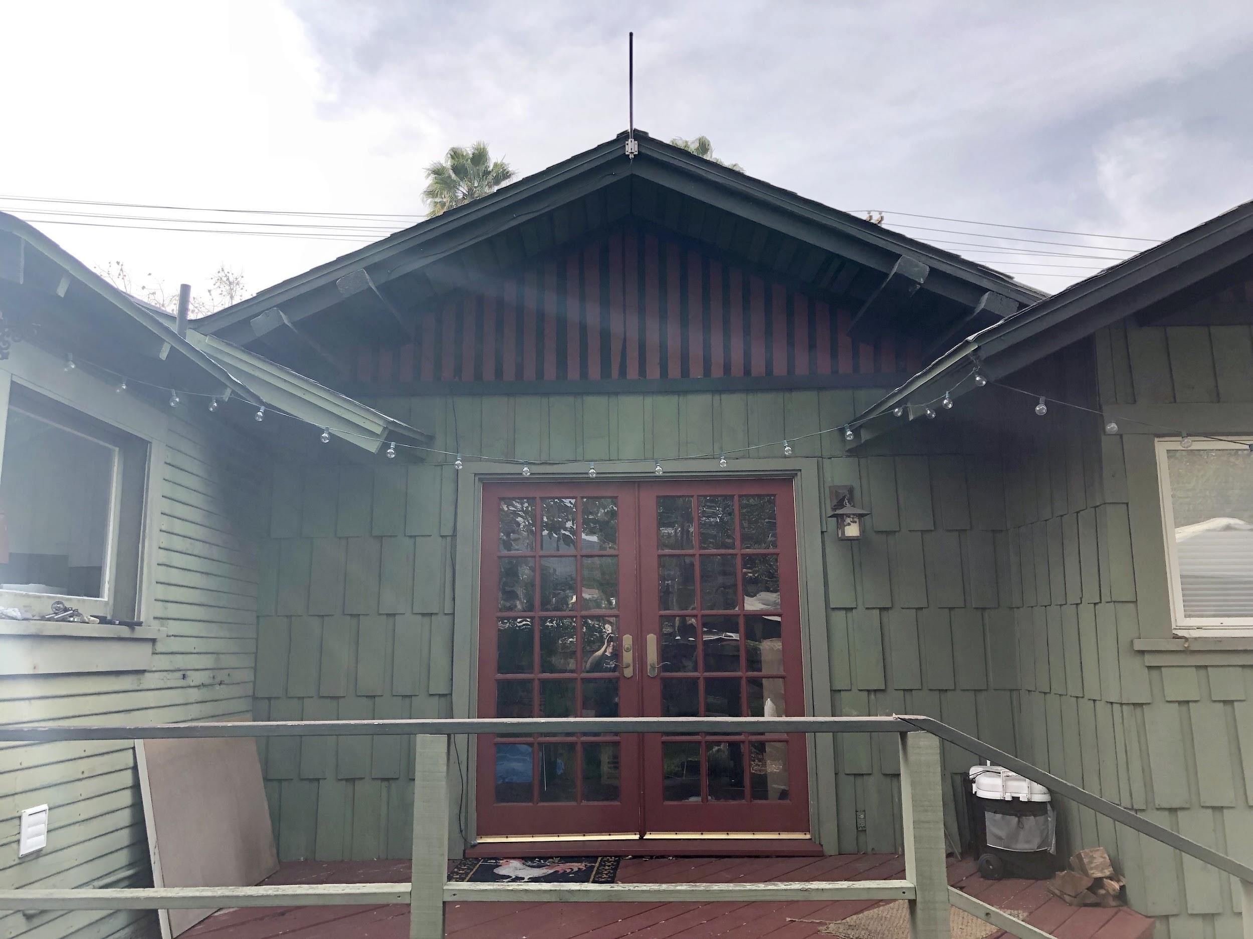

Slide 11
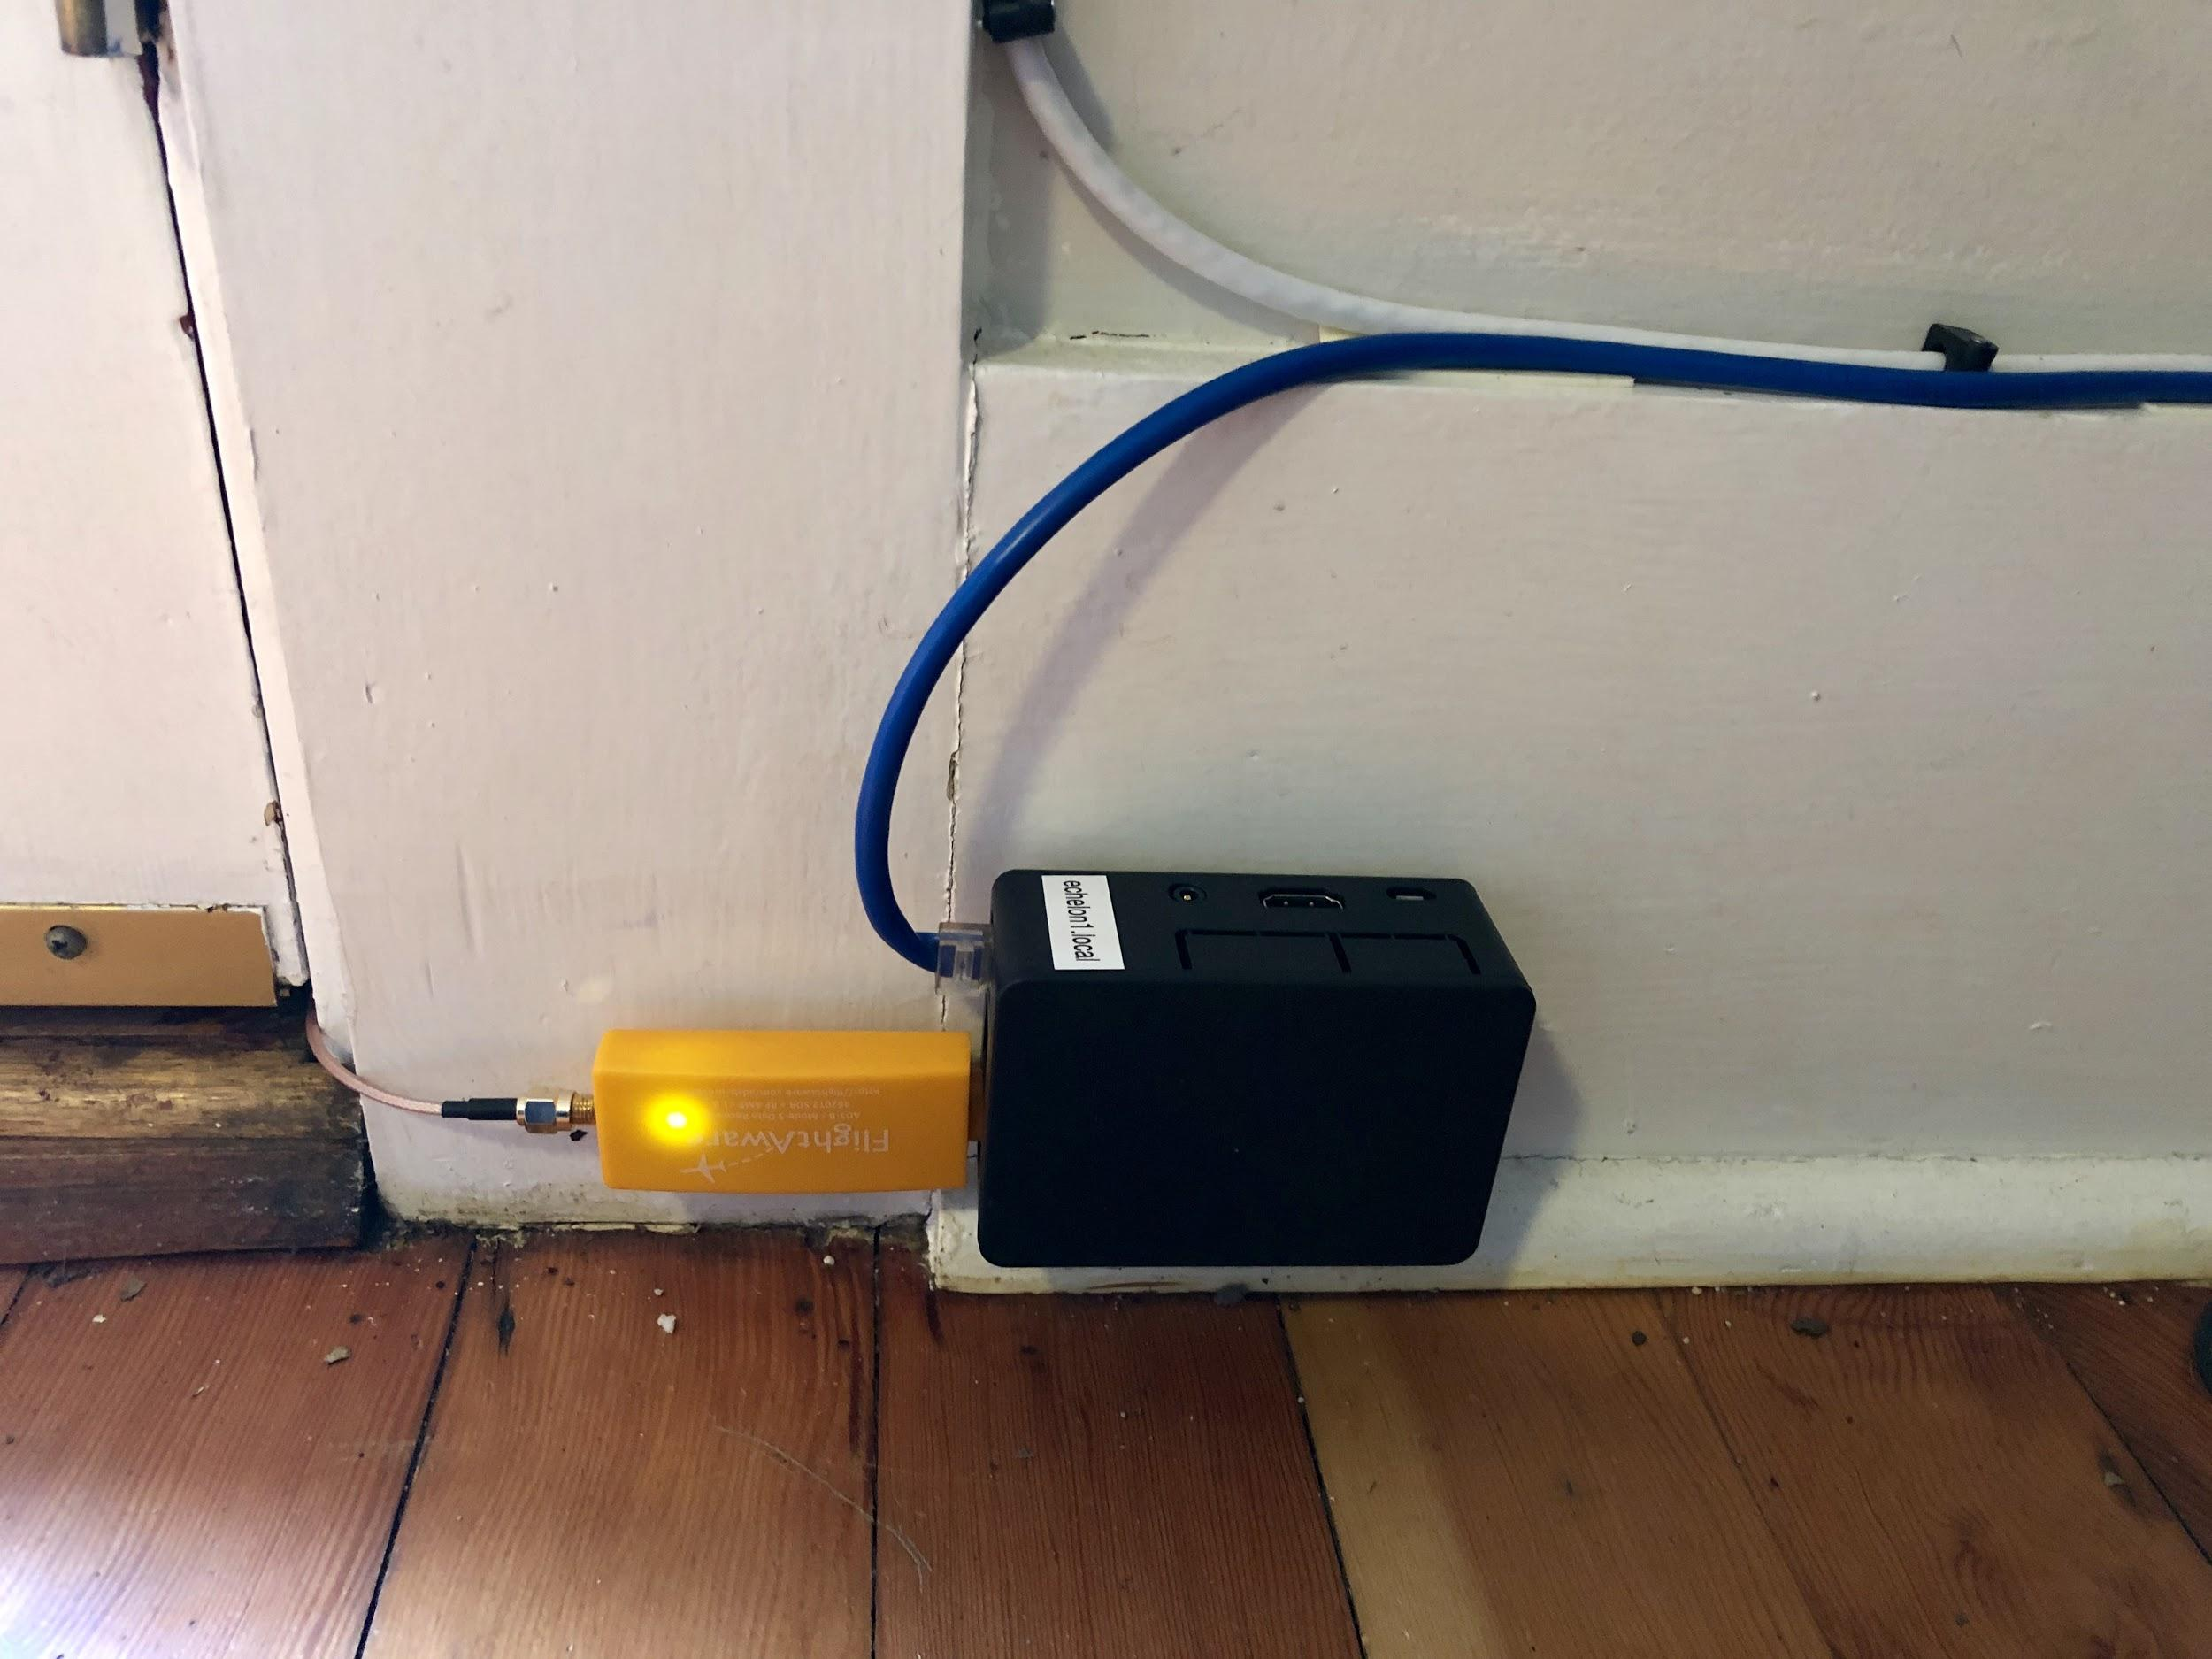
Notes:
Nowadays I use a FlightAware dongle, with built-in 1090 MHz amplifier, and a Raspberry Pi 3 with power-over-ethernet.

Slide 12
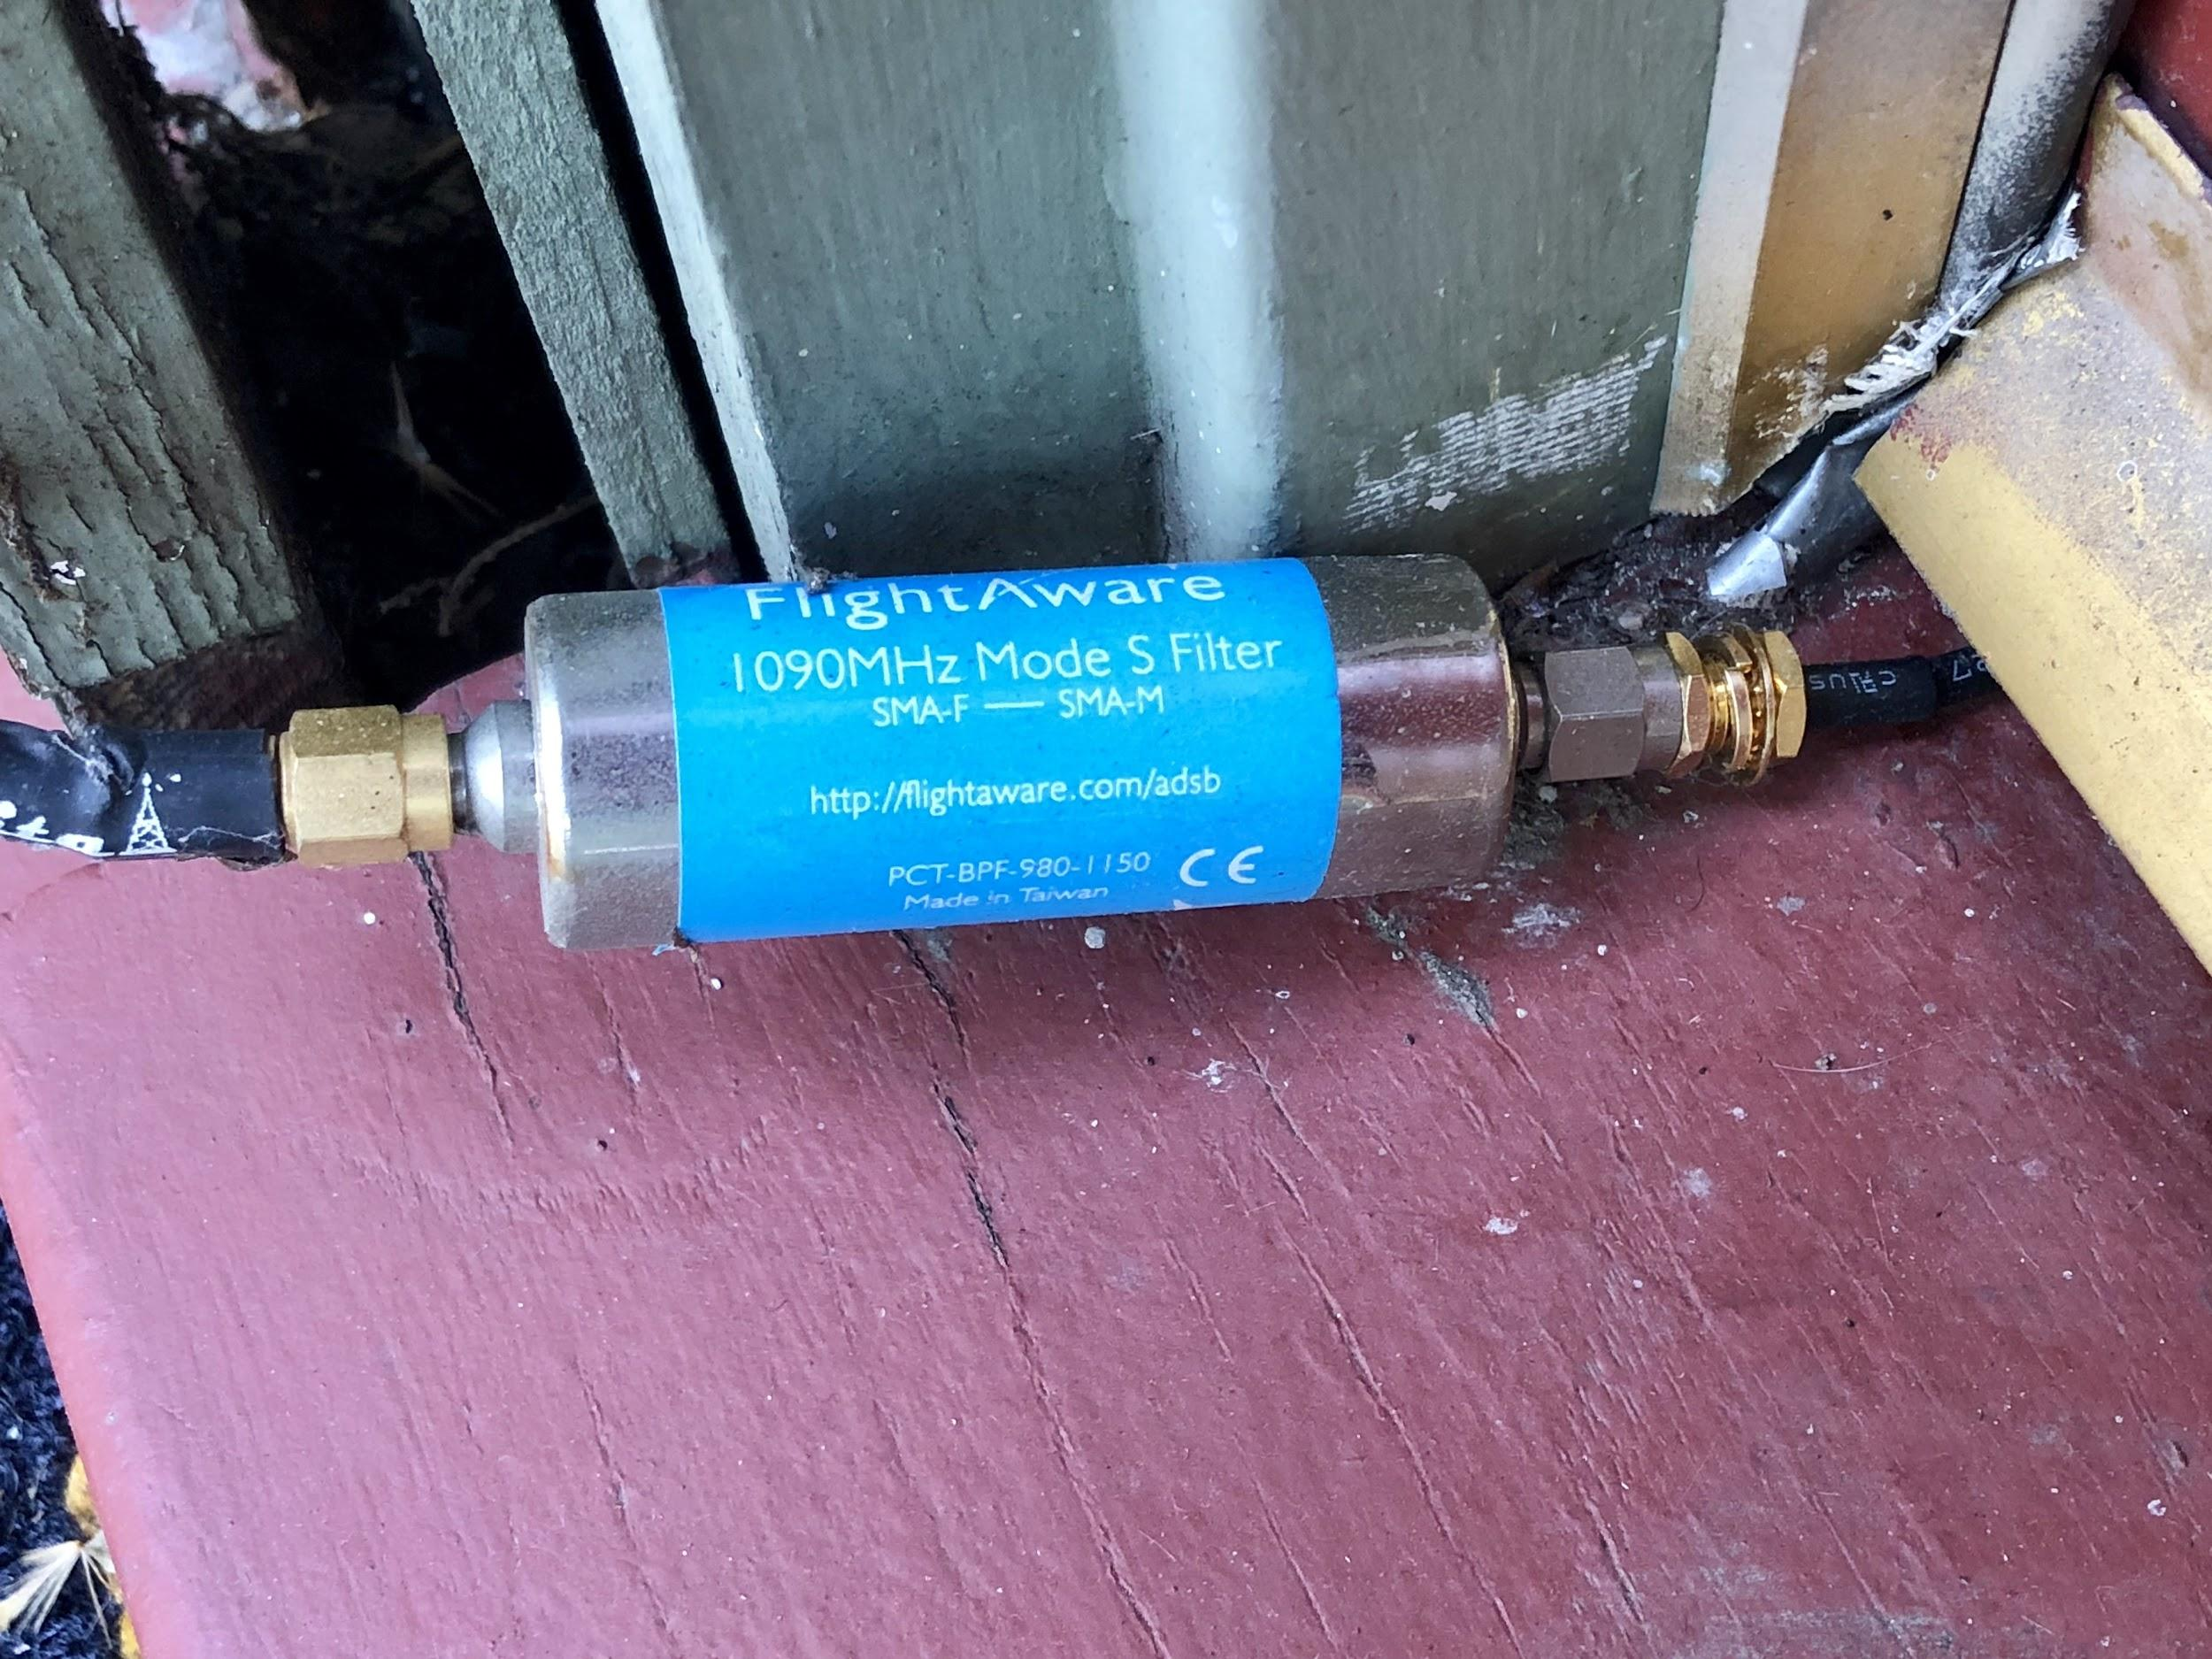
Notes:
This is a FlightAware 1090 MHz filter just before the dongle.

Slide 13
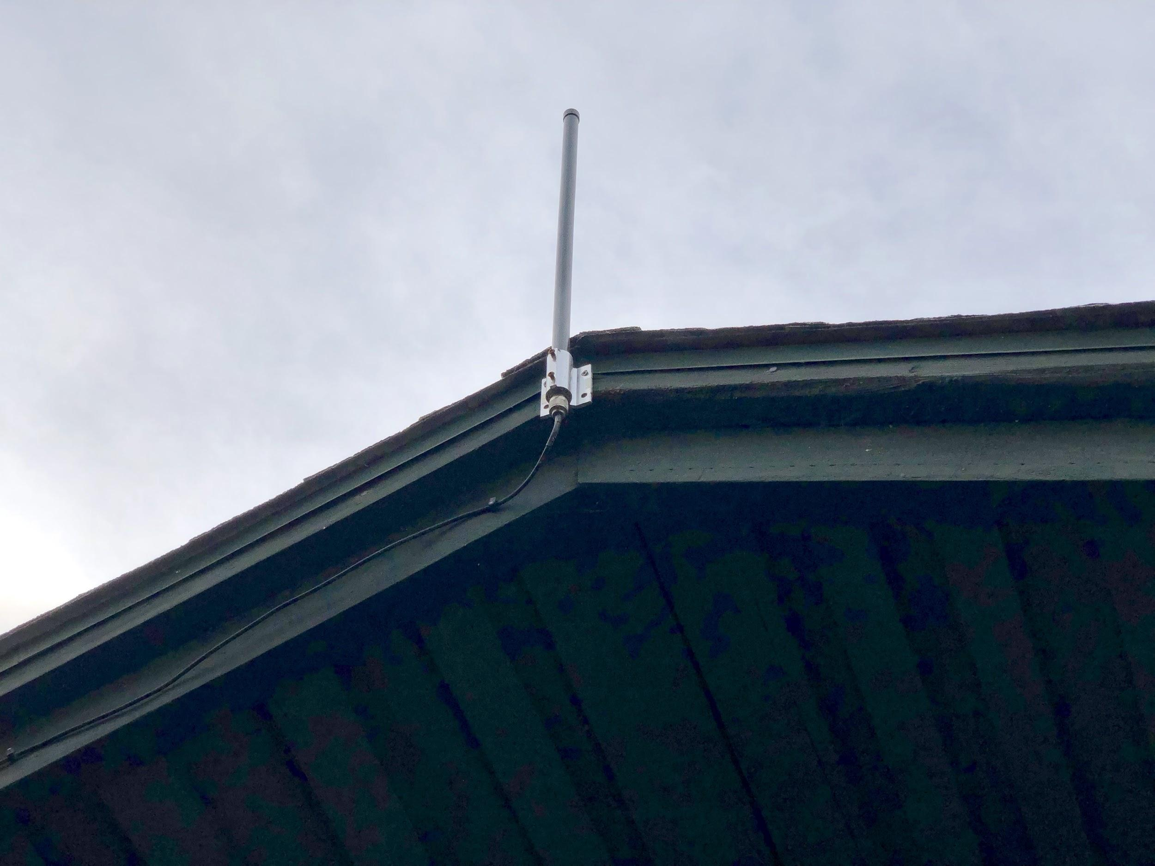
Notes:
And an antenna tuned for 1090 MHz.

Slide 14
Notes:
You can see on this version of the listening station, I’d tuned to a reference signal and determined that my dongle had a 40 PPM error that I needed to compensate for.

Slide 15
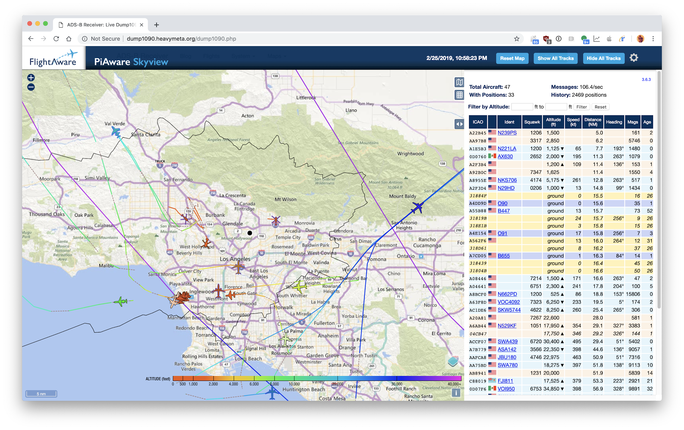
FA dump1090
Notes:
You can go from a fresh Raspberry Pi to having a full browser-based radar-like display in under an hour.

Slide 16
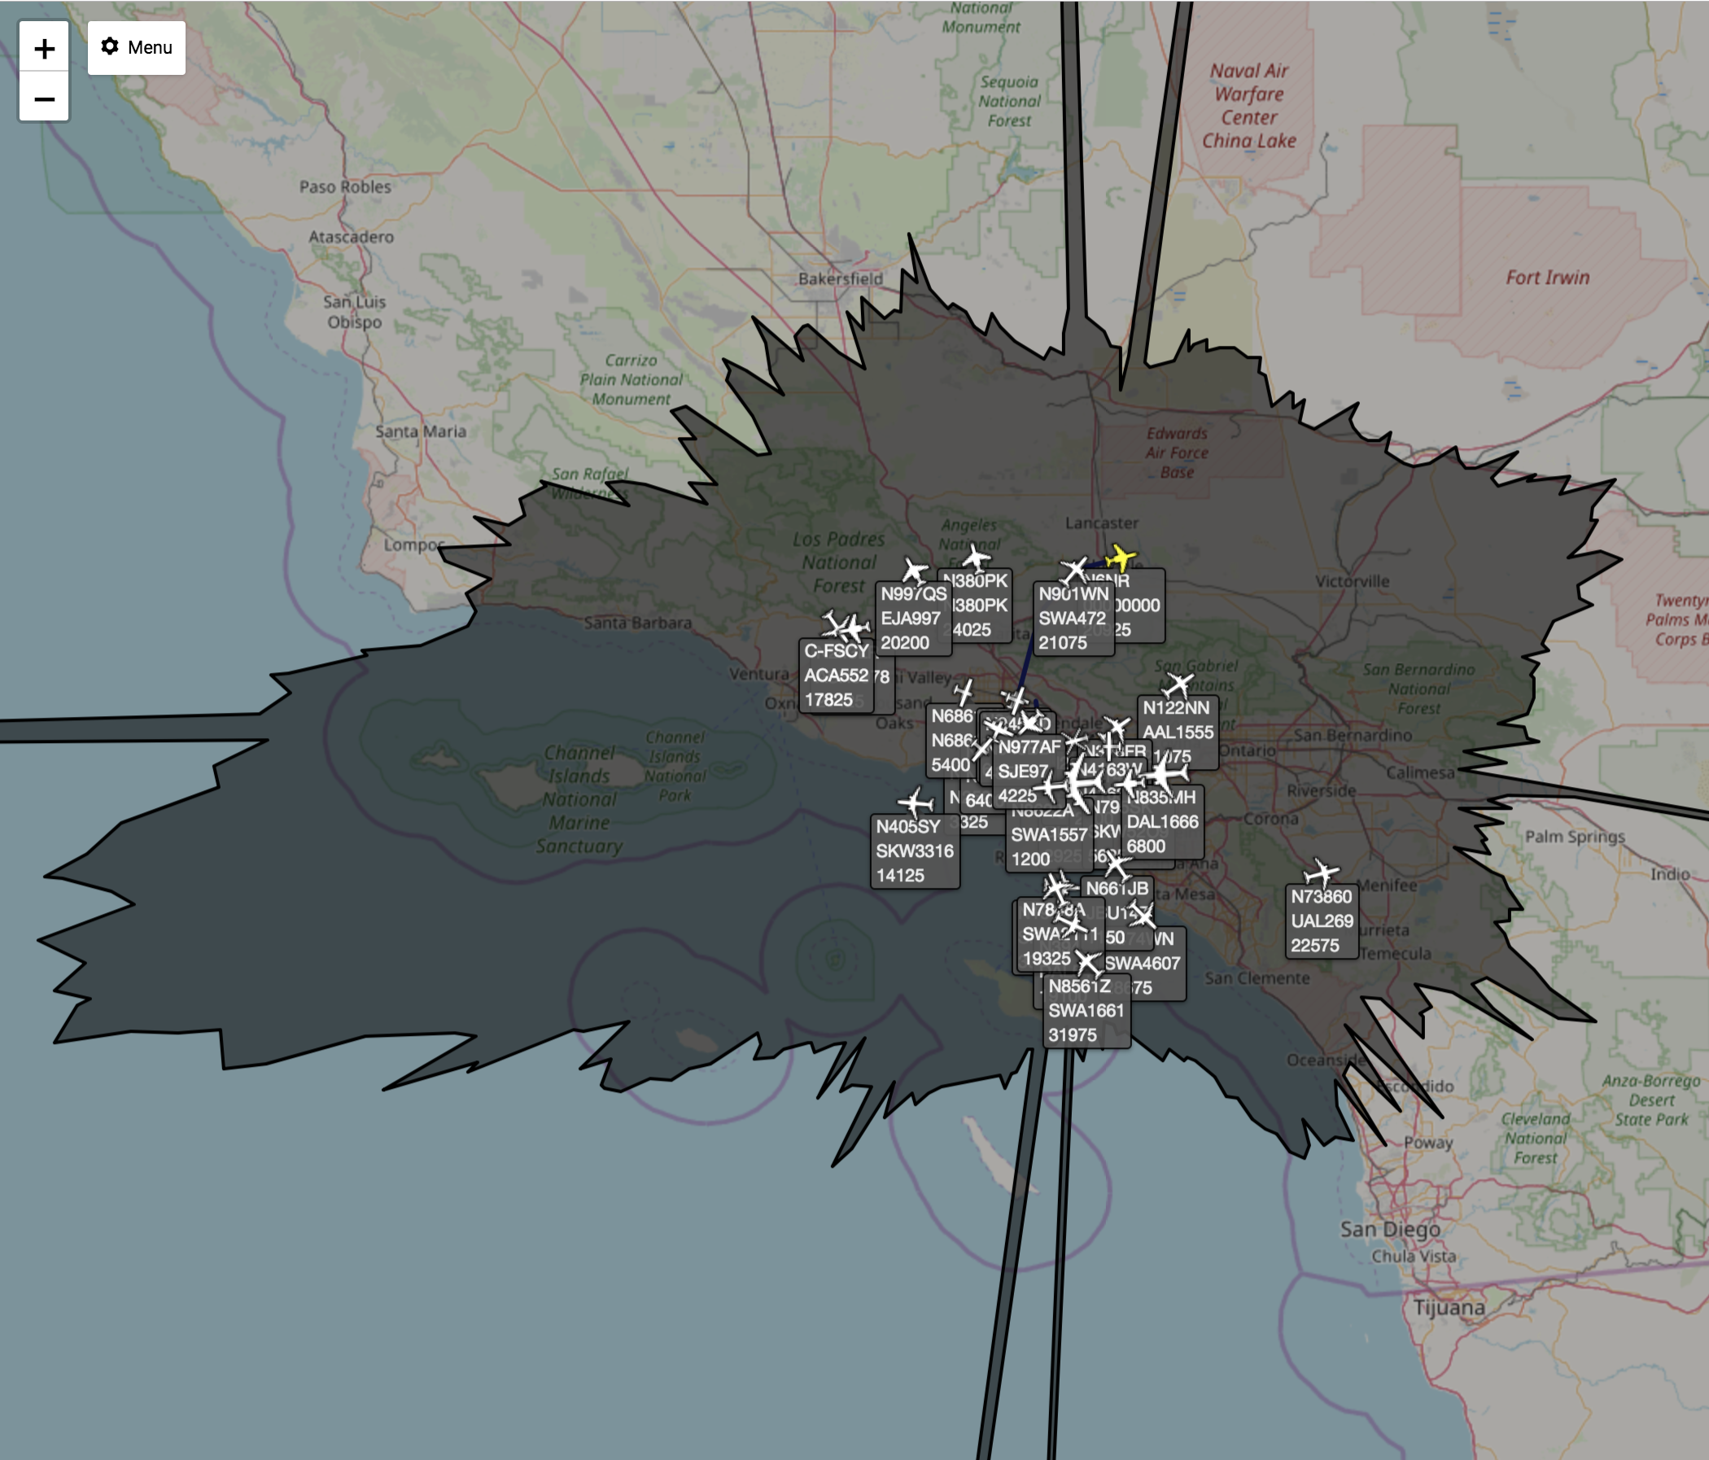
Notes:
This shows my approximate reception range, though I do sometimes pick up aircraft as far as Vegas, San Diego, and even Arizona.

Slide 17
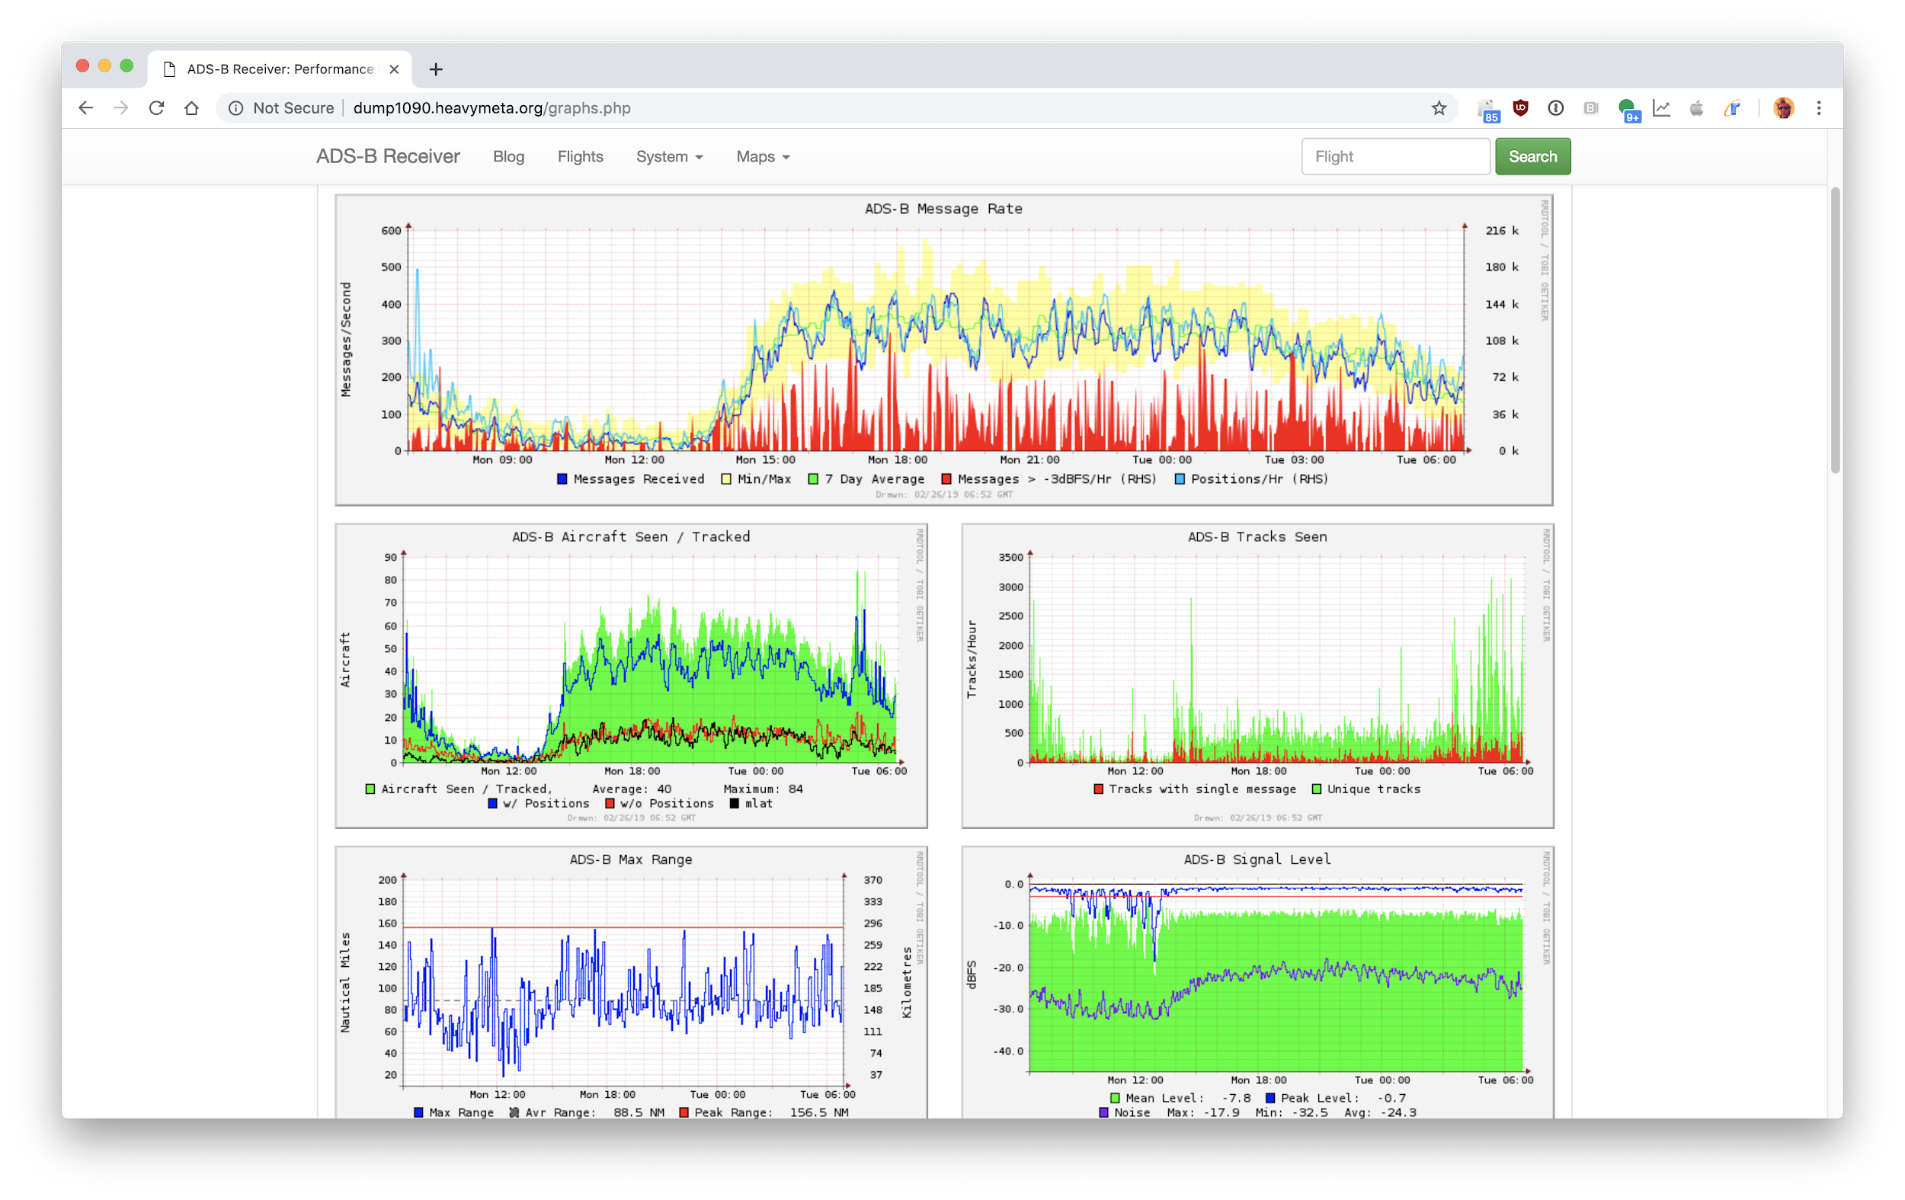
Dashboard
Notes:
There’s an easy-to-install package that even includes a nice dashboard showing system stats.

Slide 18
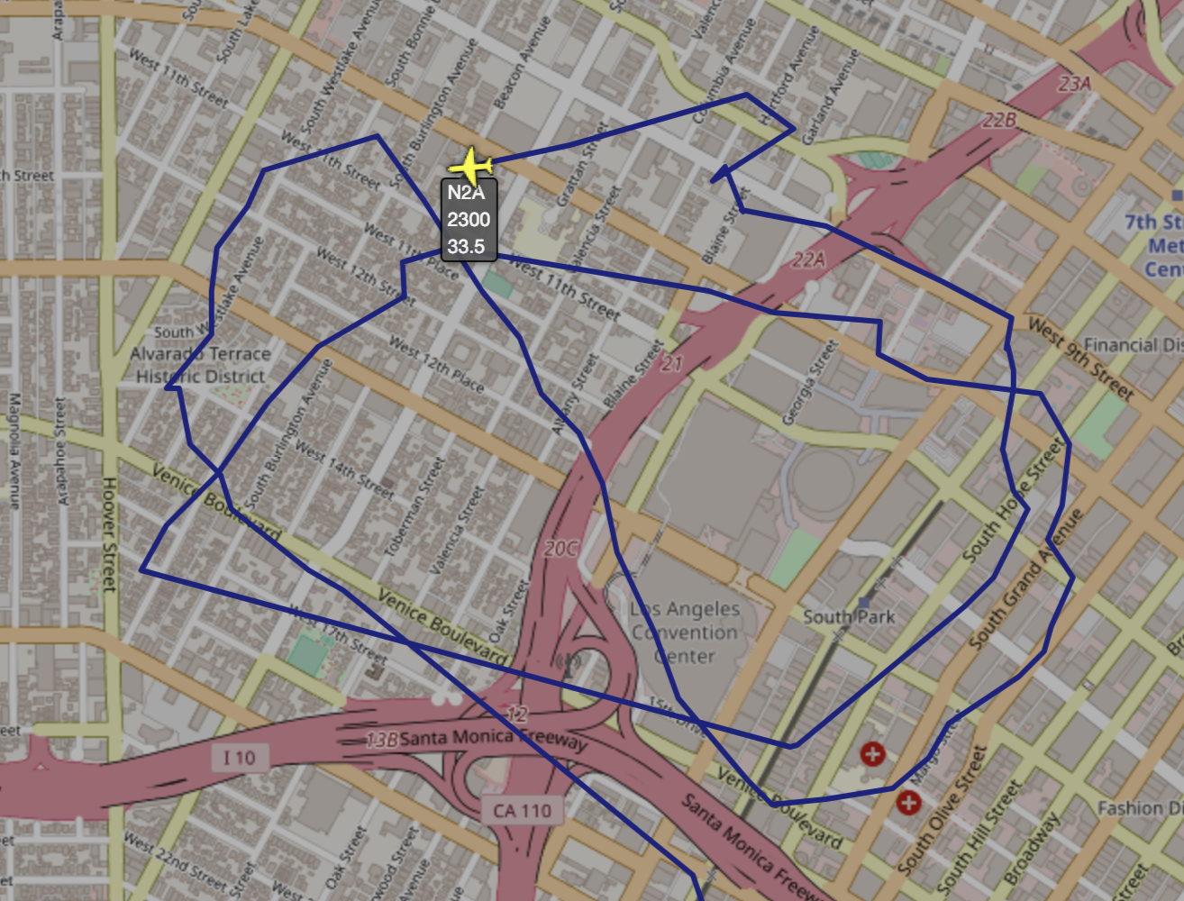
Goodyear blimp
Notes:
Now we begin our survey of interesting things you see over Los Angeles.

Slide 19
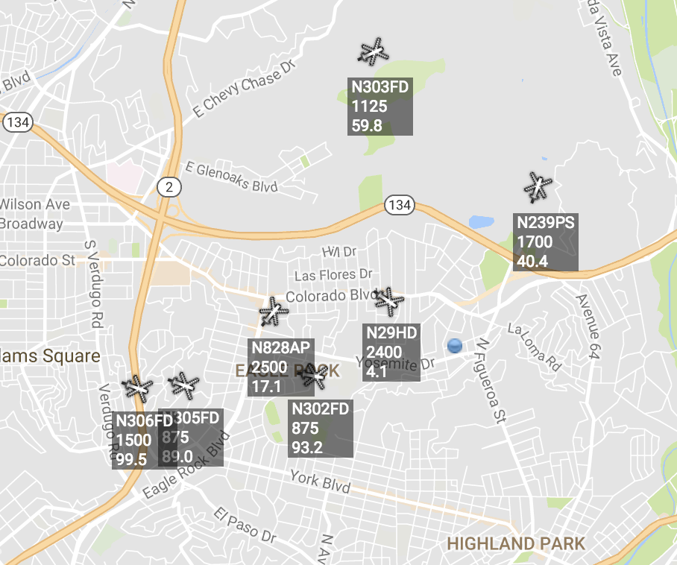
Fire in Eagle Rock
Notes:
5 LAFD helicopters, a Pasadena PD helicopter, and a news chopper.

Slide 20
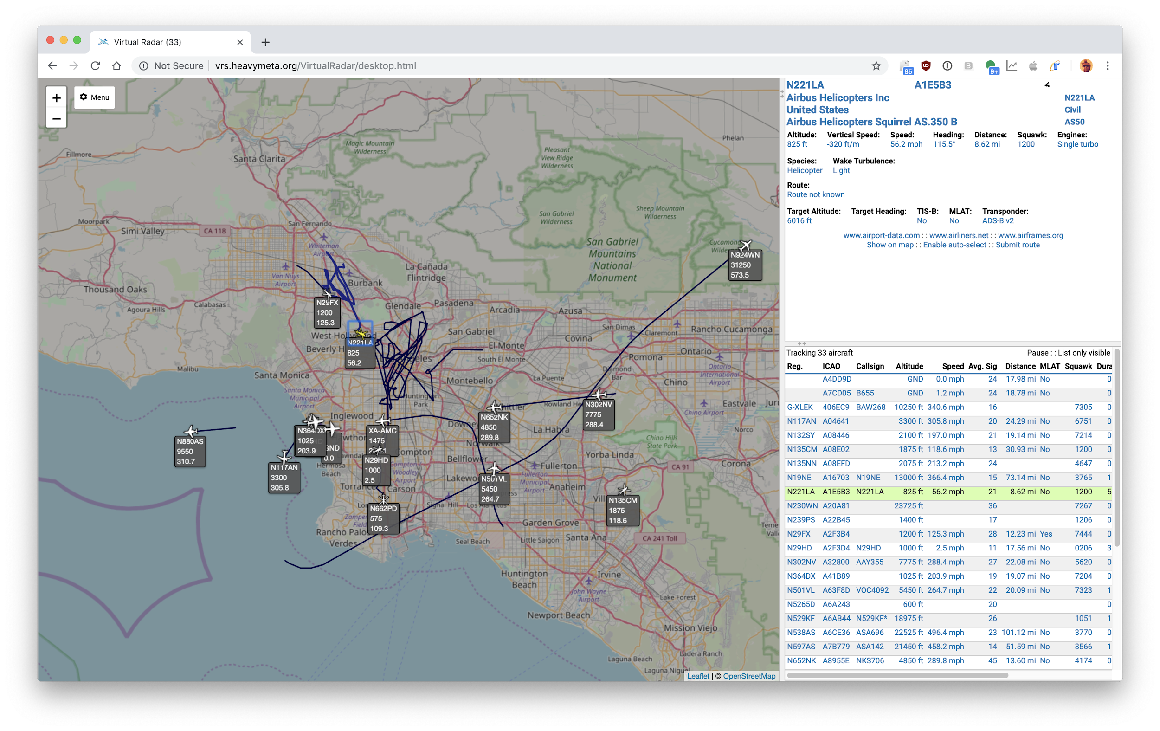
LAPD

Slide 21
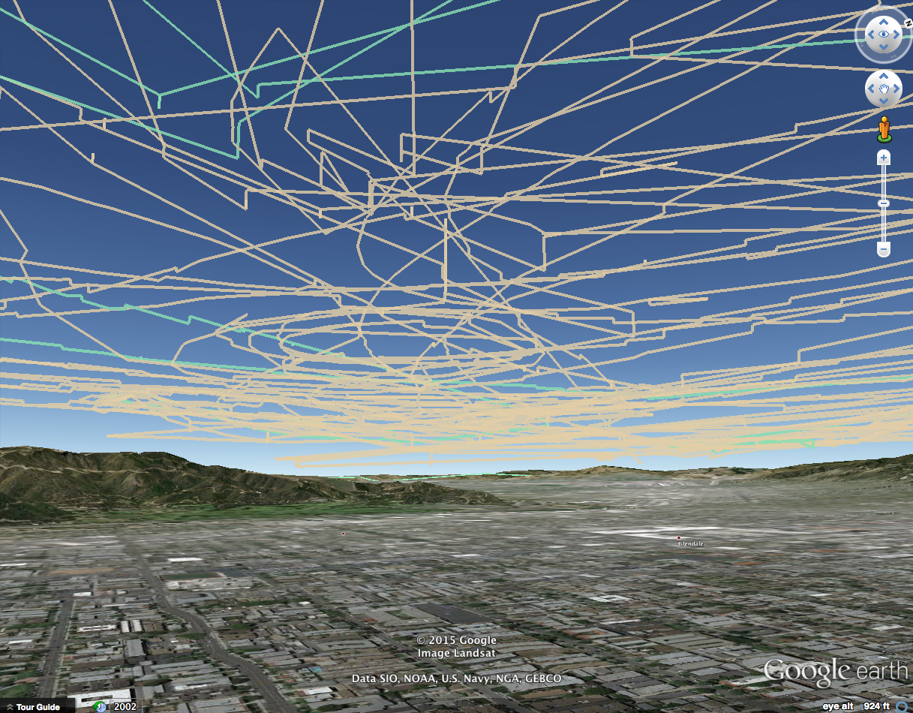
Burbank & Glendale PD
Notes:
This shows just a few days of flight paths from a Burbank/Glendale PD helicopter. It seems like there’s always a helicopter overhead because there’s always a helicopter overhead.

Slide 22
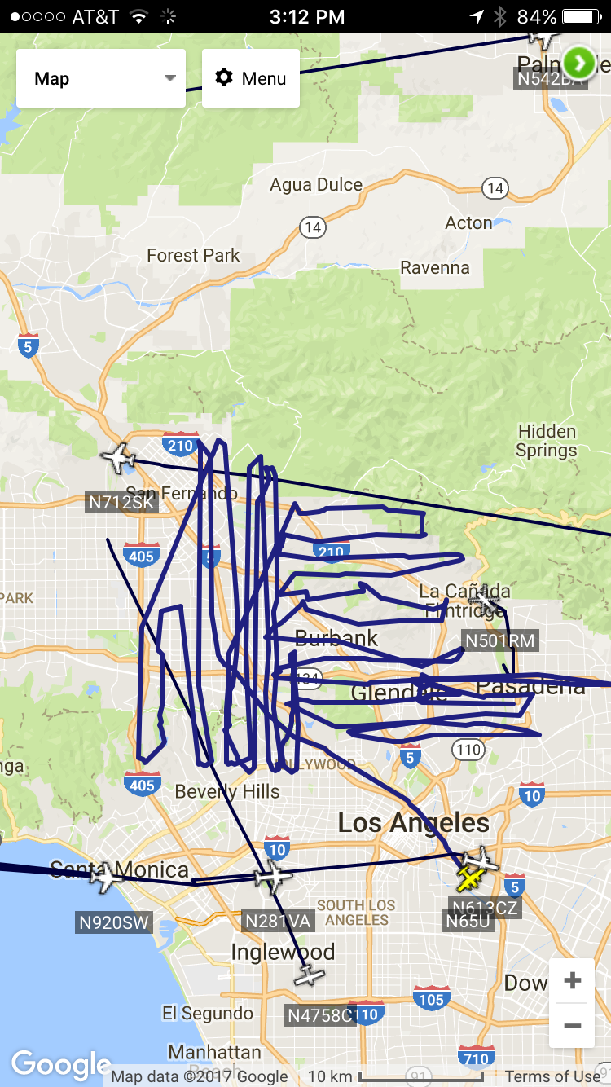
Sterile Insect Technique
Notes:
One of the first things I noticed was a shadowy military contractor flying planes in weird patterns over LA several times a week. OMG, should I blow the whistle on them?! I waited and did more research, and it turns out they’re dropping thousands of sterile fruit flies as part of a fruit fly eradication program.

Slide 23
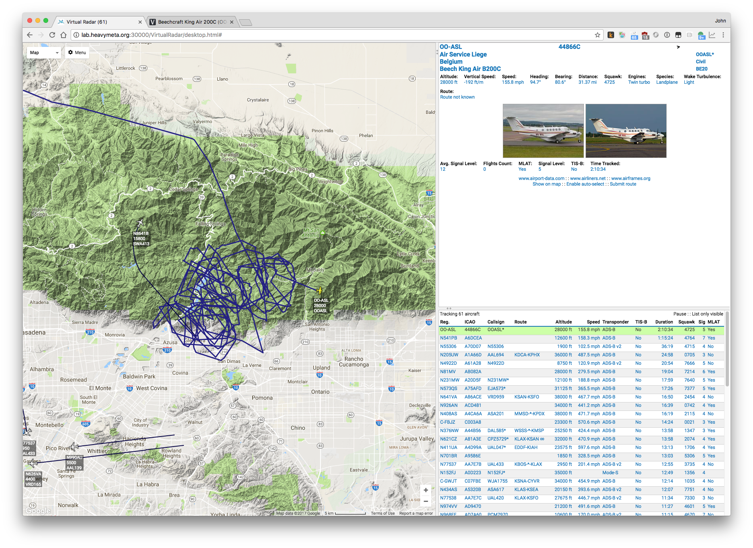
Tour of California TV relay

Slide 24
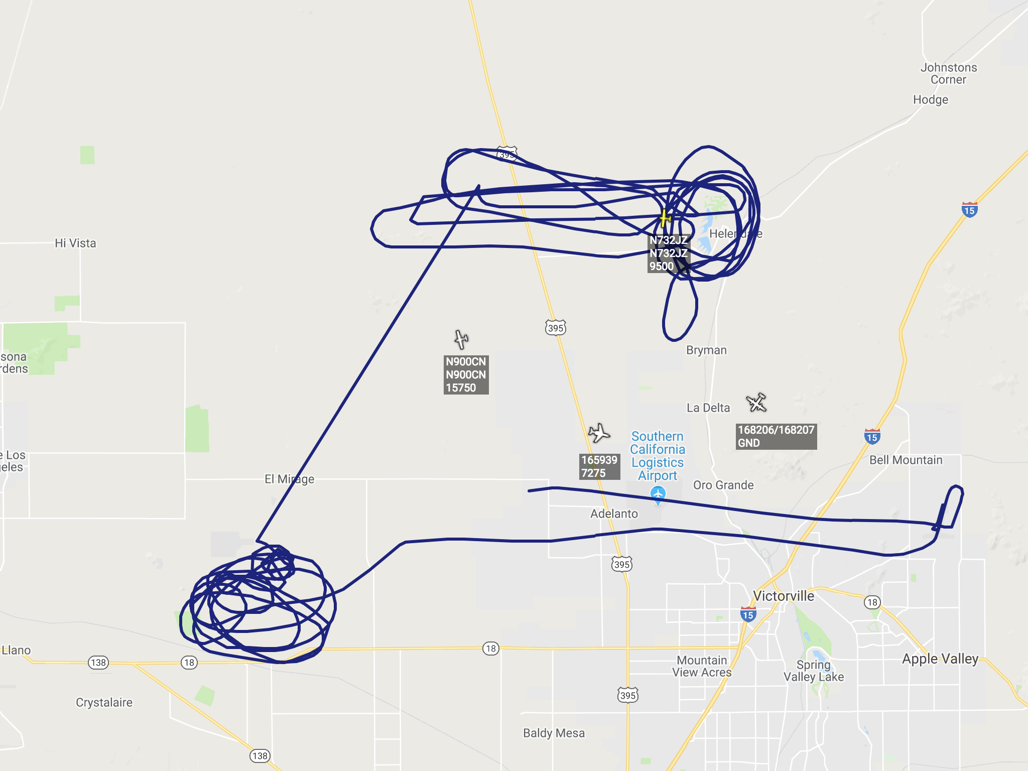
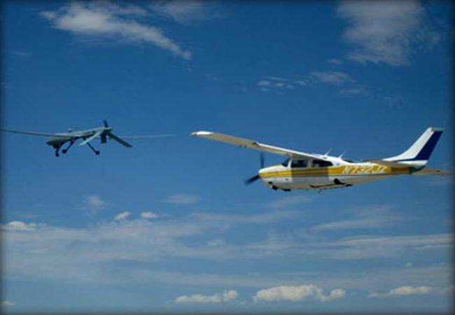
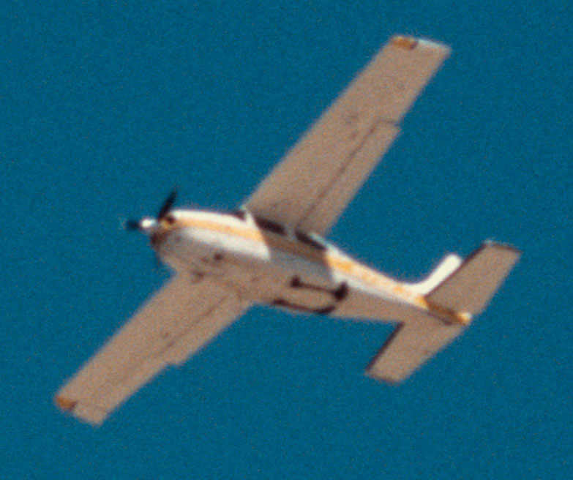
Chalk 2, Inc.
Notes:
This plane out over the desert is registered to Chalk 2, Inc. (a military reference), and is used as a UAV chase plane.

Slide 25
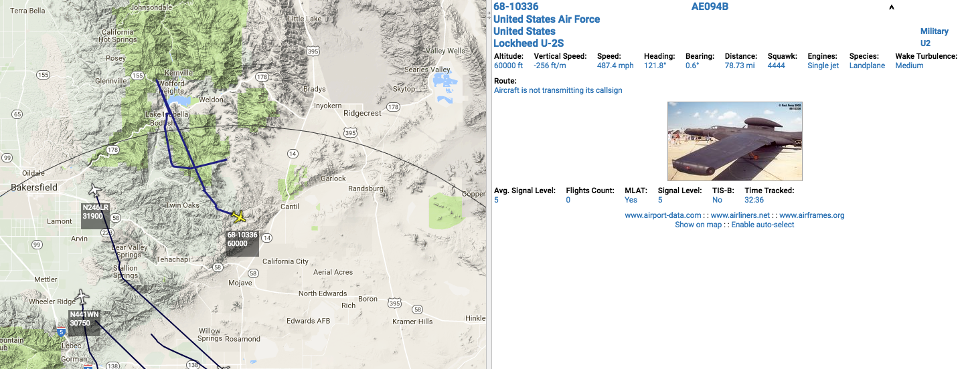
U-2
Notes:
There’s a U-2 test range to the north. They limit the altitude the transponder reports to 60,000 feet but they’re actually flying higher.

Slide 26
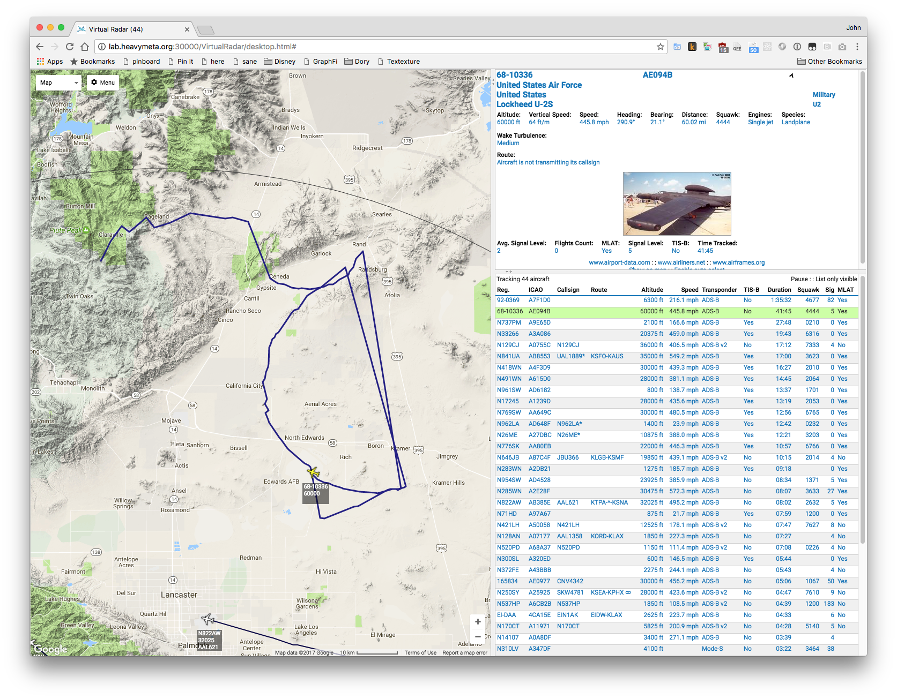
U-2 (and Air Cerberus)
Notes:
You can see what happens when I lose line-of-sight for a portion of a flight. Air Cerberus… We’ll come back to them.

Slide 27
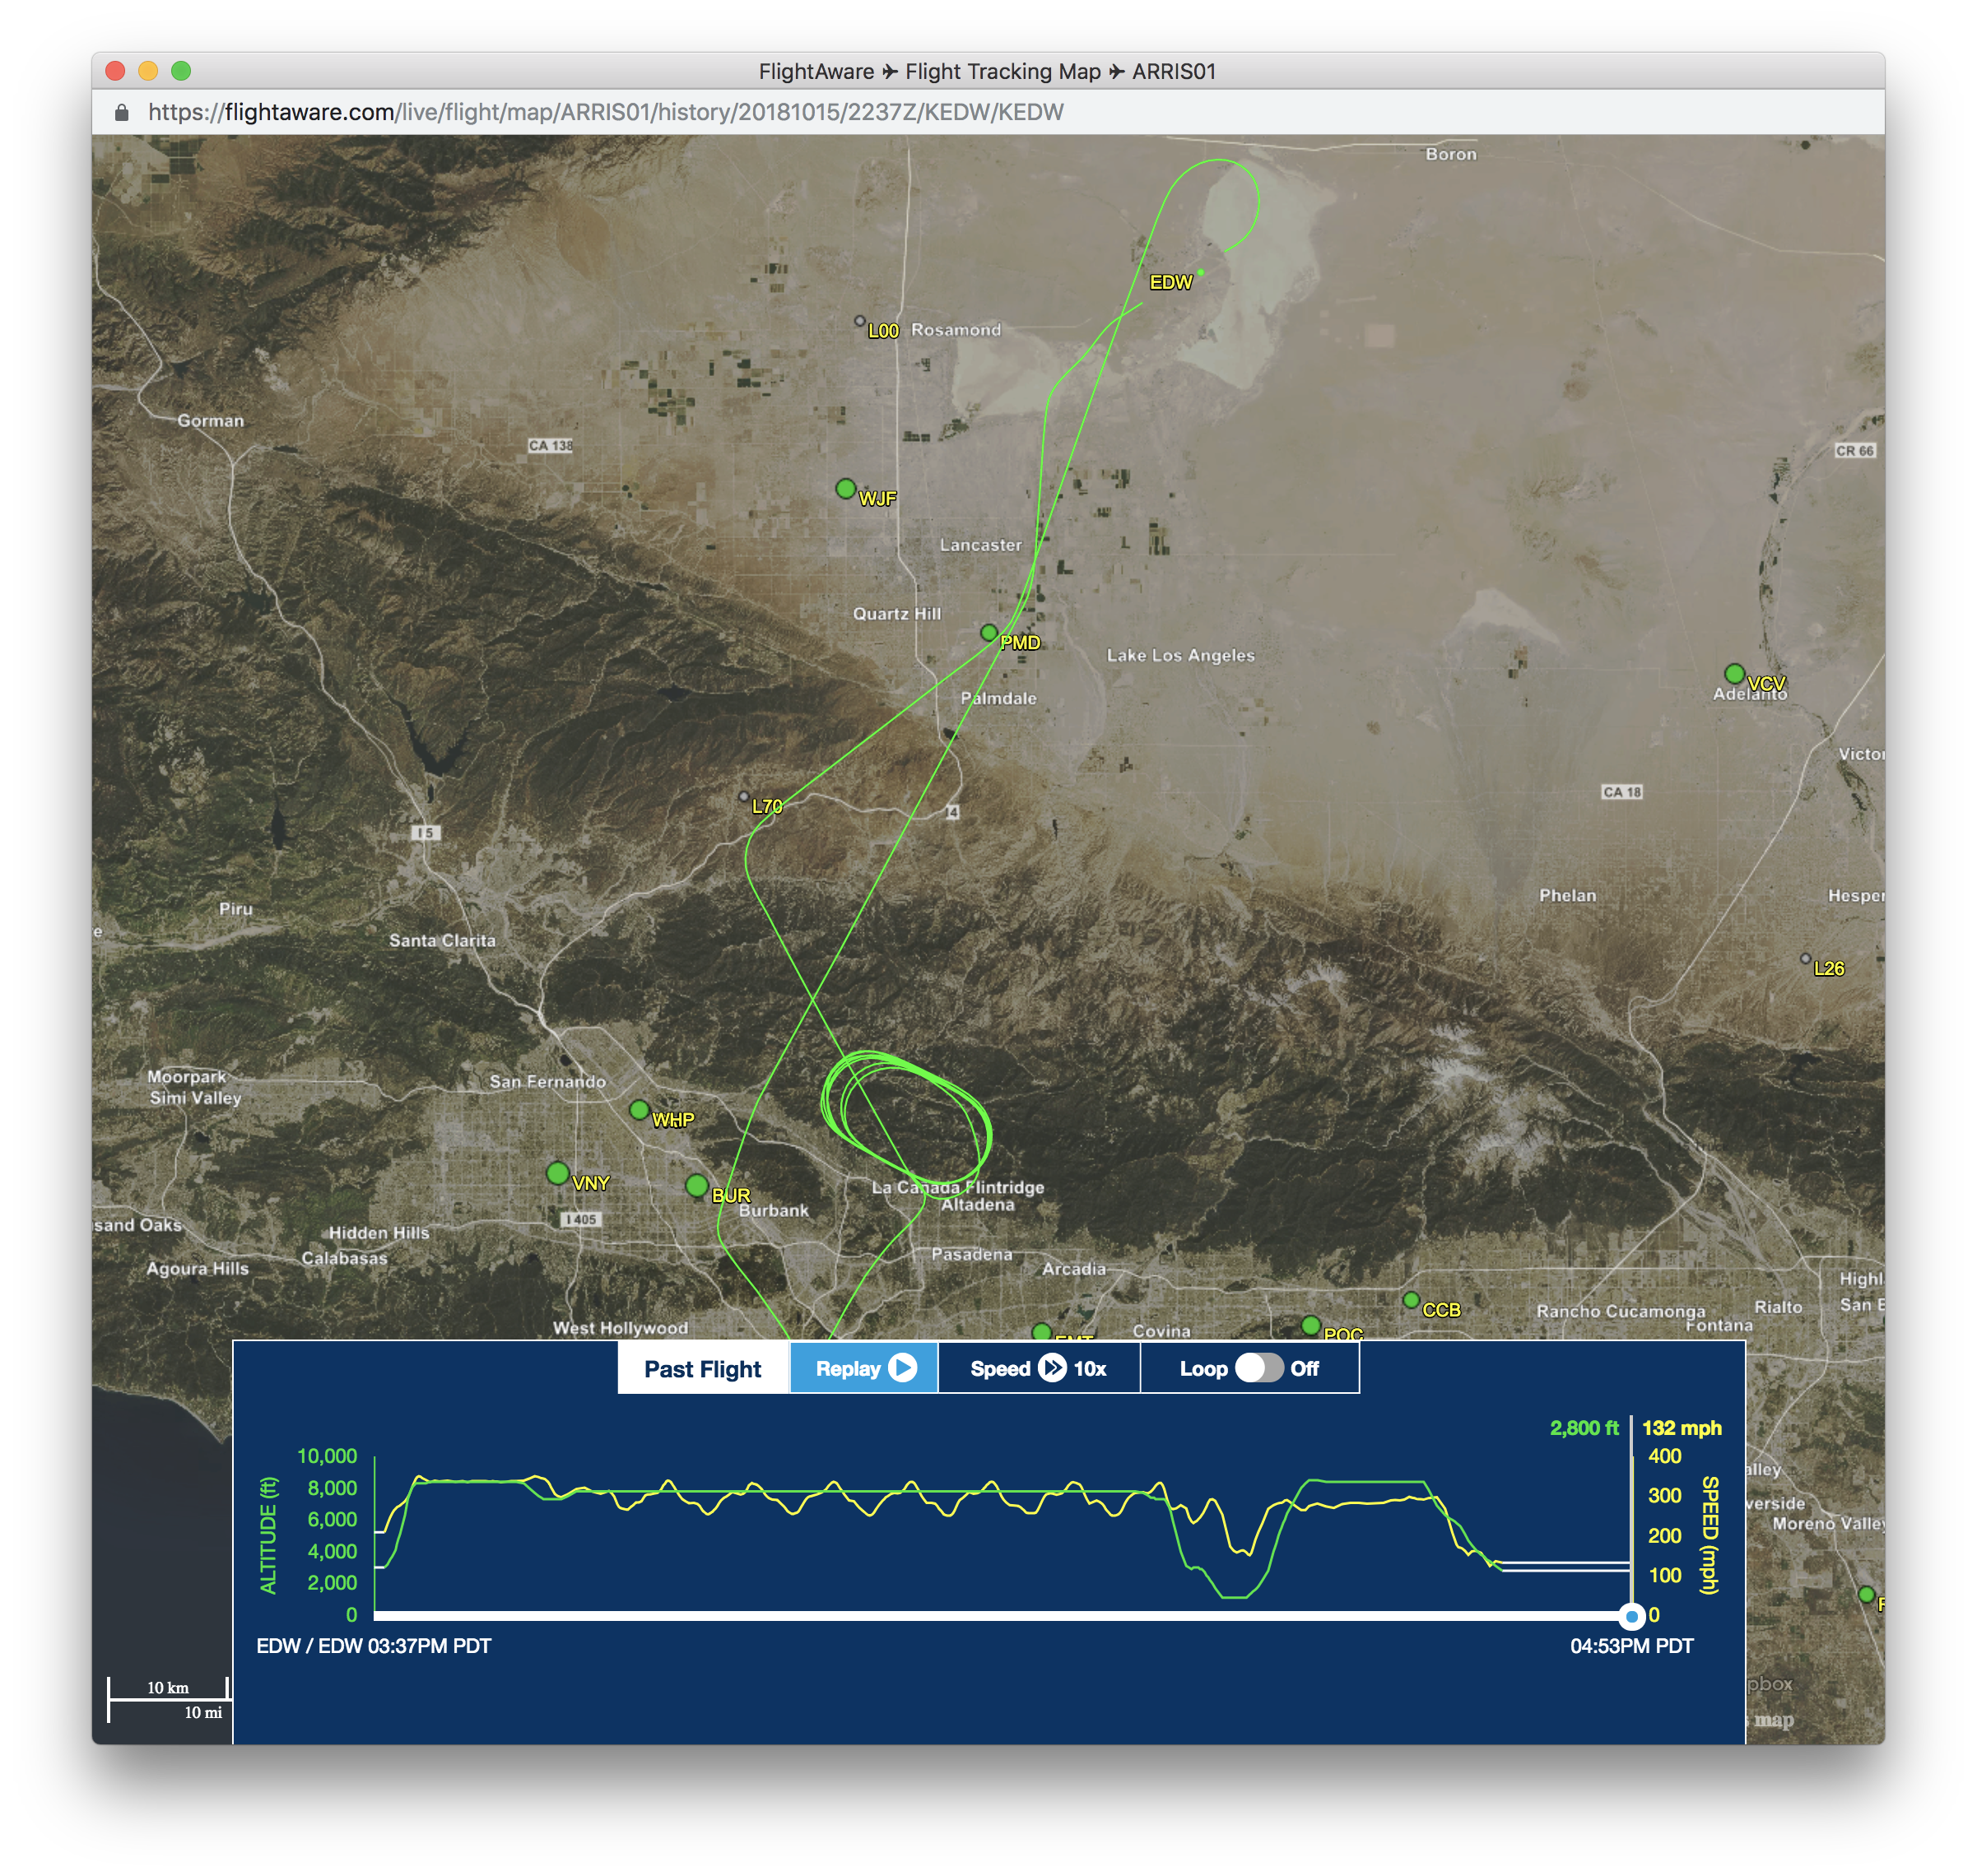
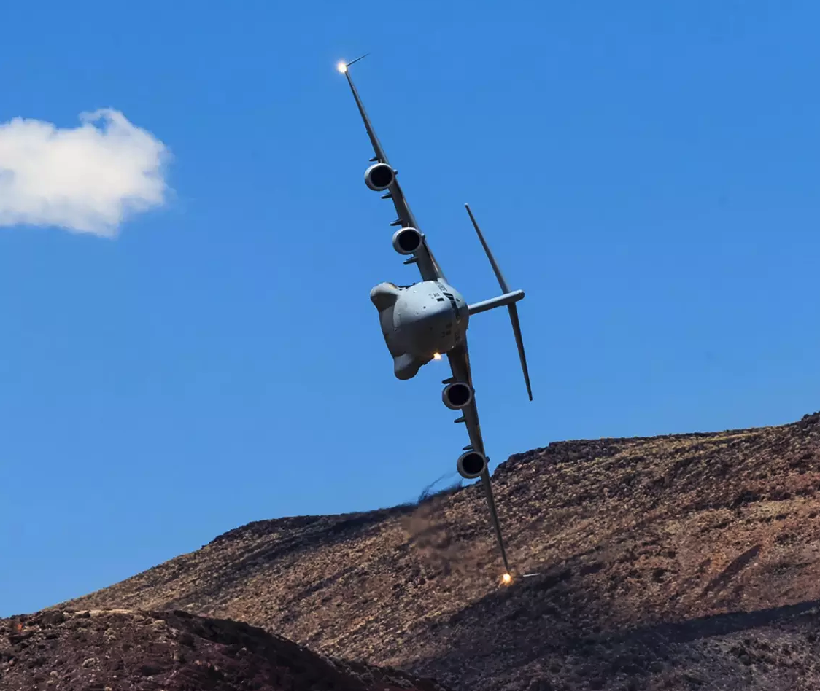
C-17 Jedi
Notes:
One day while driving home, I saw a giant C-17 fly over my car at low altitude. When I got home I checked, and it was barely at 1000 feet. It was on its way to a stadium flyover (and is a plane known for doing aggressive, photogenic training in Star Wars canyon, which is the photo on the right).

Slide 28
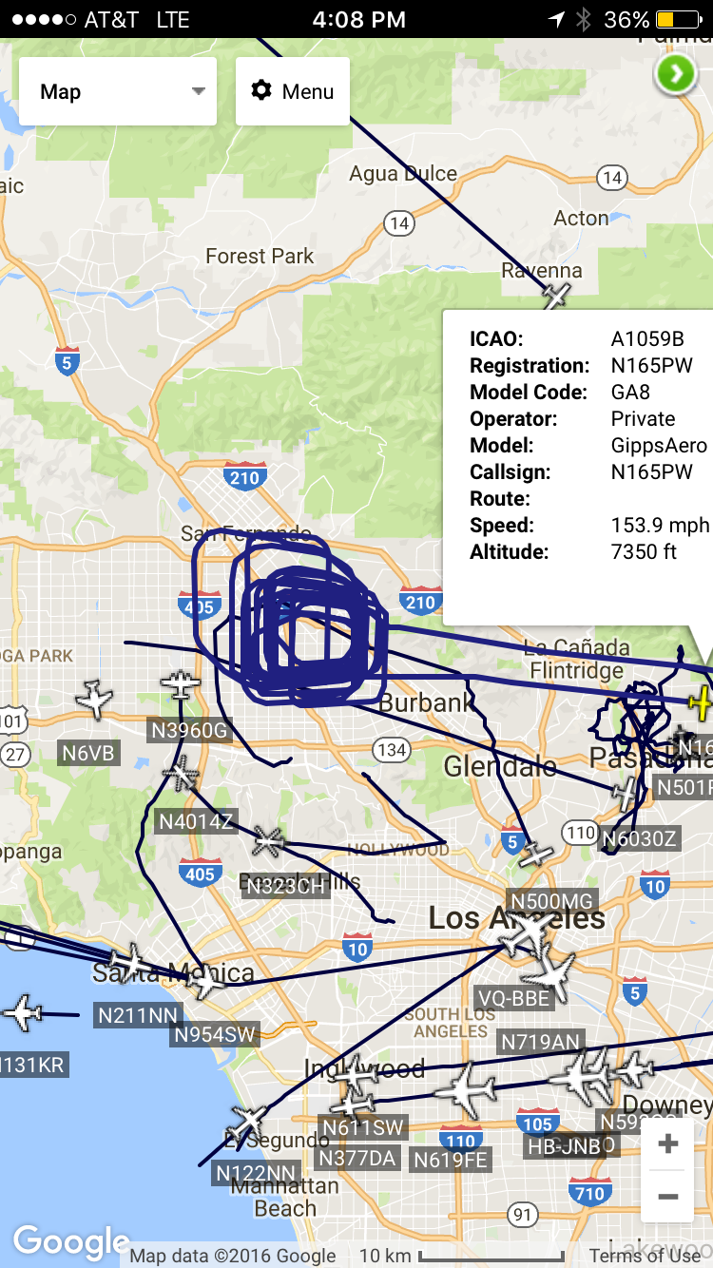
San Bernardino Sheriff
Notes:
Why are they flying a square circle? I don’t know.

Slide 29
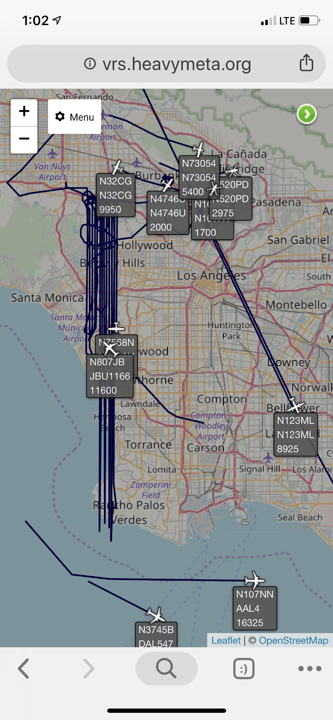
Keystone Aerial Surveys
Notes:
Another lawnmower pattern, but much tighter than the Dynamic Aviation sterile insect technique flights. Keystone seems to do some military/intelligence work too.

Slide 30
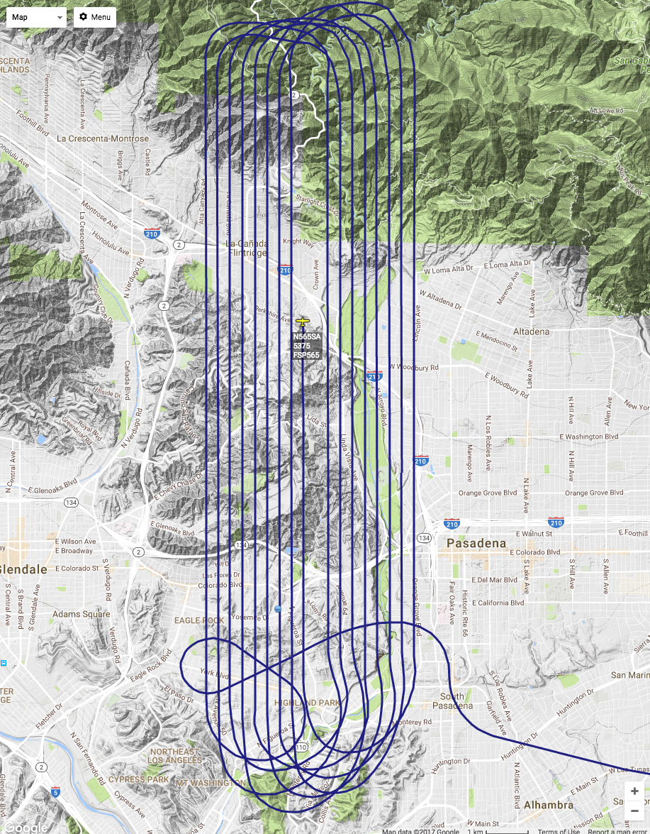
Aperture Aviation (mapping) (Wells Fargo)
Notes:
Look at how precise that is. This plane is actually registered to Wells Fargo, which is a commonly used technique to obscure ownership. Often you can dig up enough to track down the real owner.

Slide 31
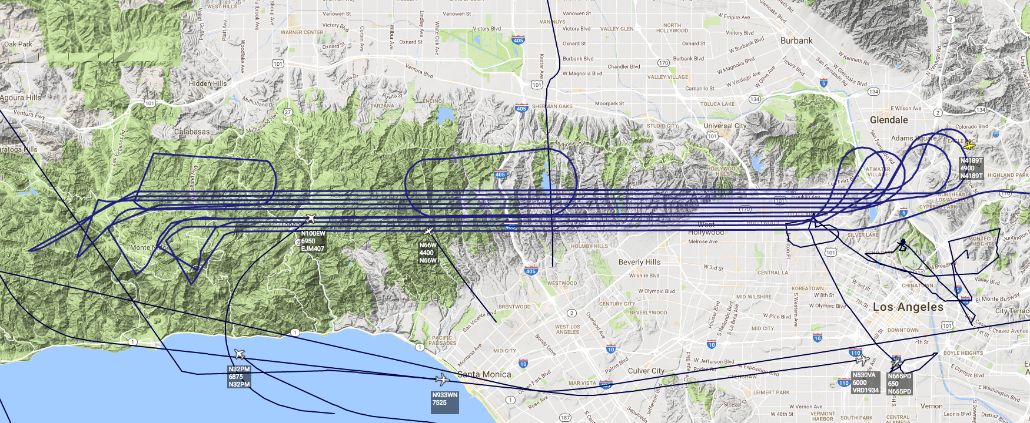
Keystone Aerial Surveys (and SIT)

Slide 32
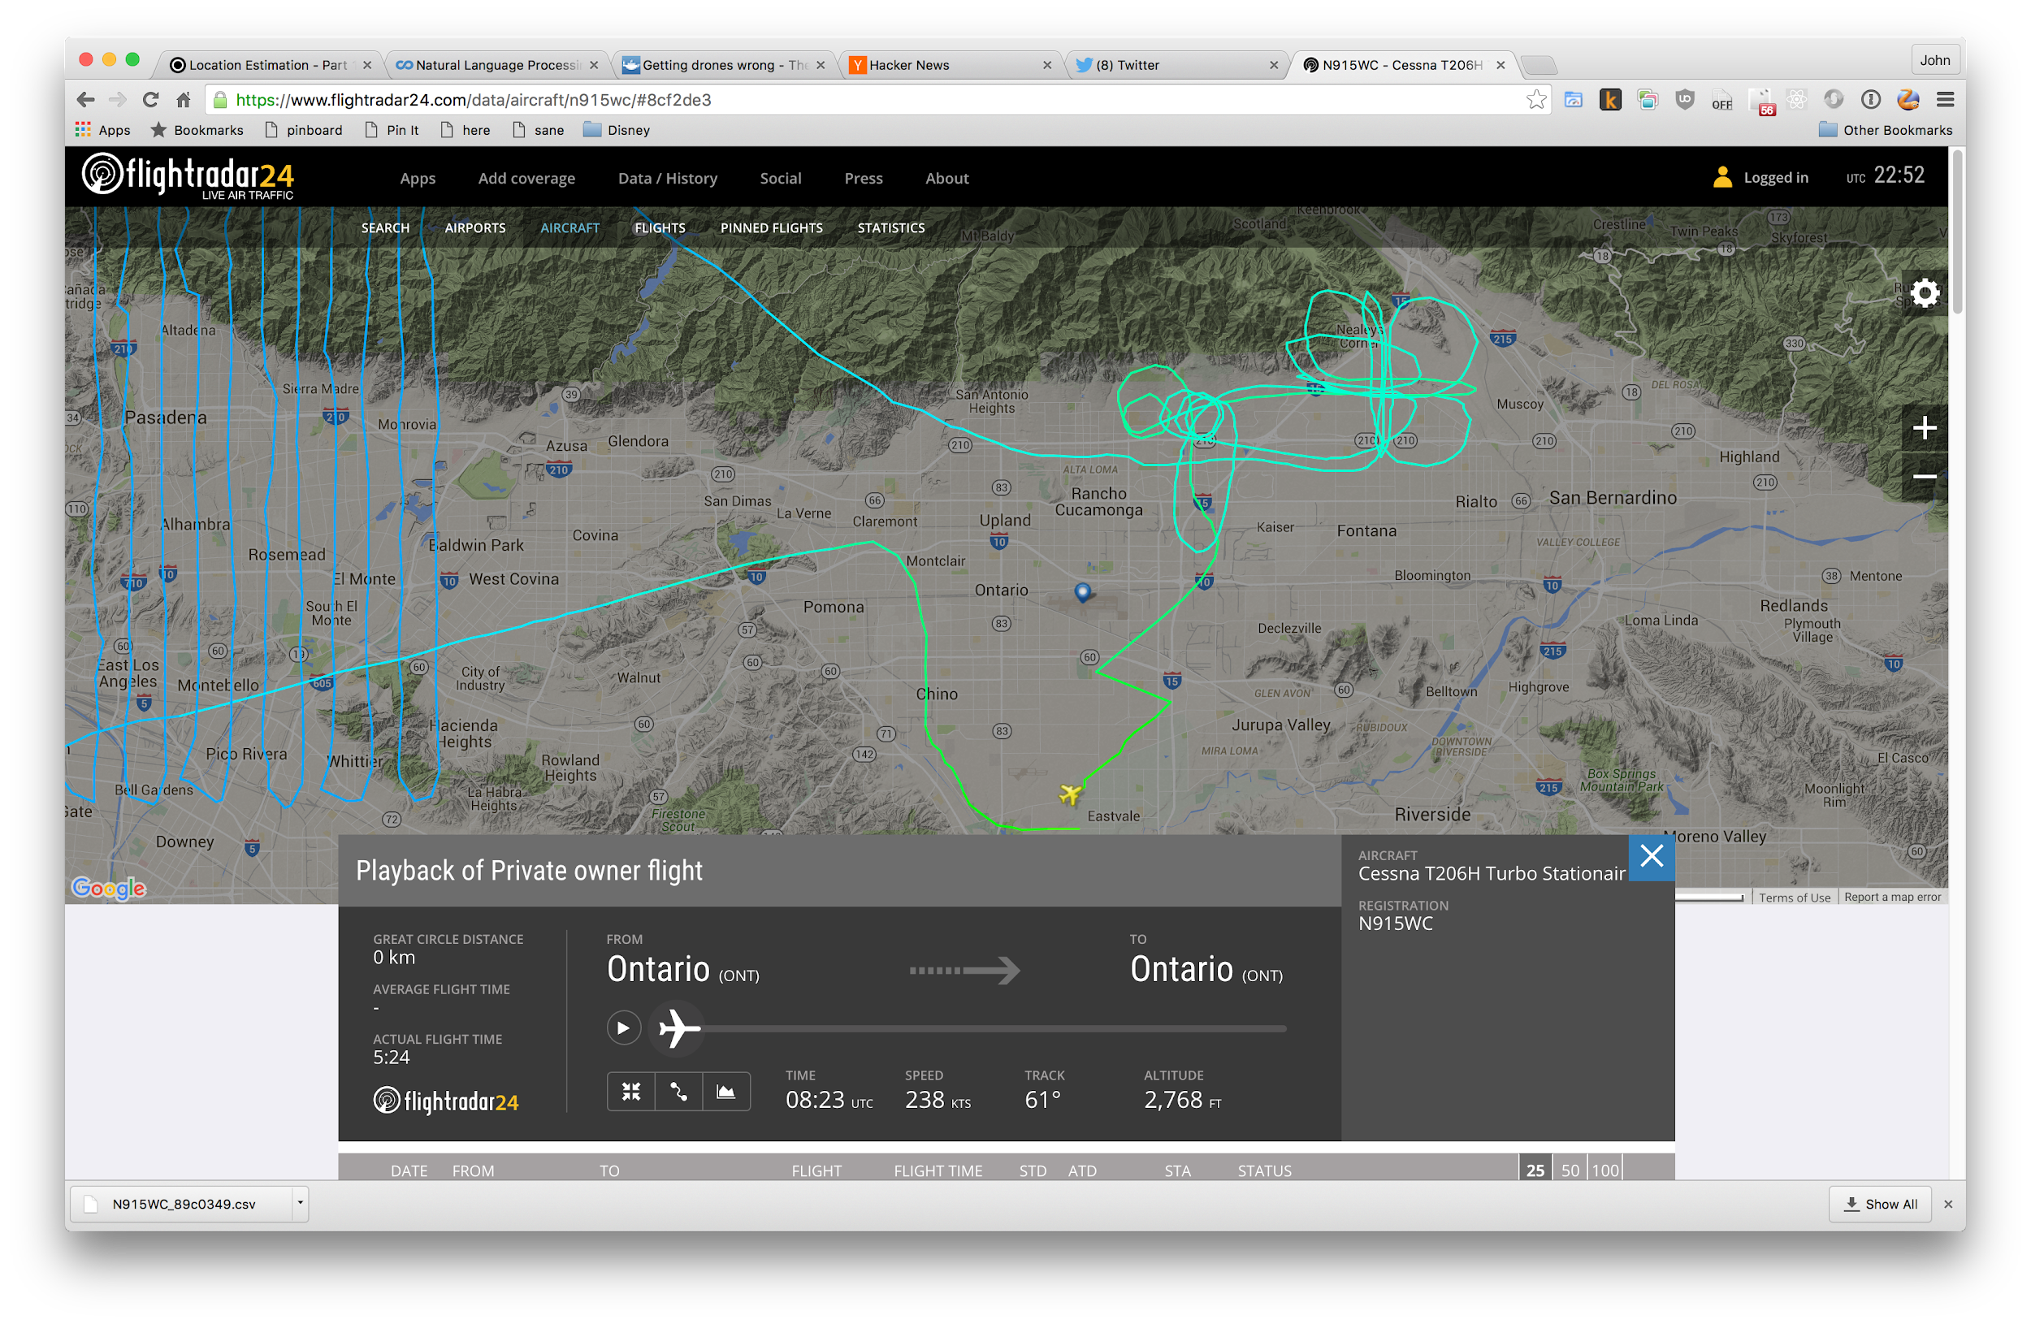
Aerial imagery? (Aeroptic Inc.)
Notes:
What’s the significance of the clover-leaf pattern? I don’t know. Some aerial mapping companies are known to be fronts for doing government surveillance.

Slide 33
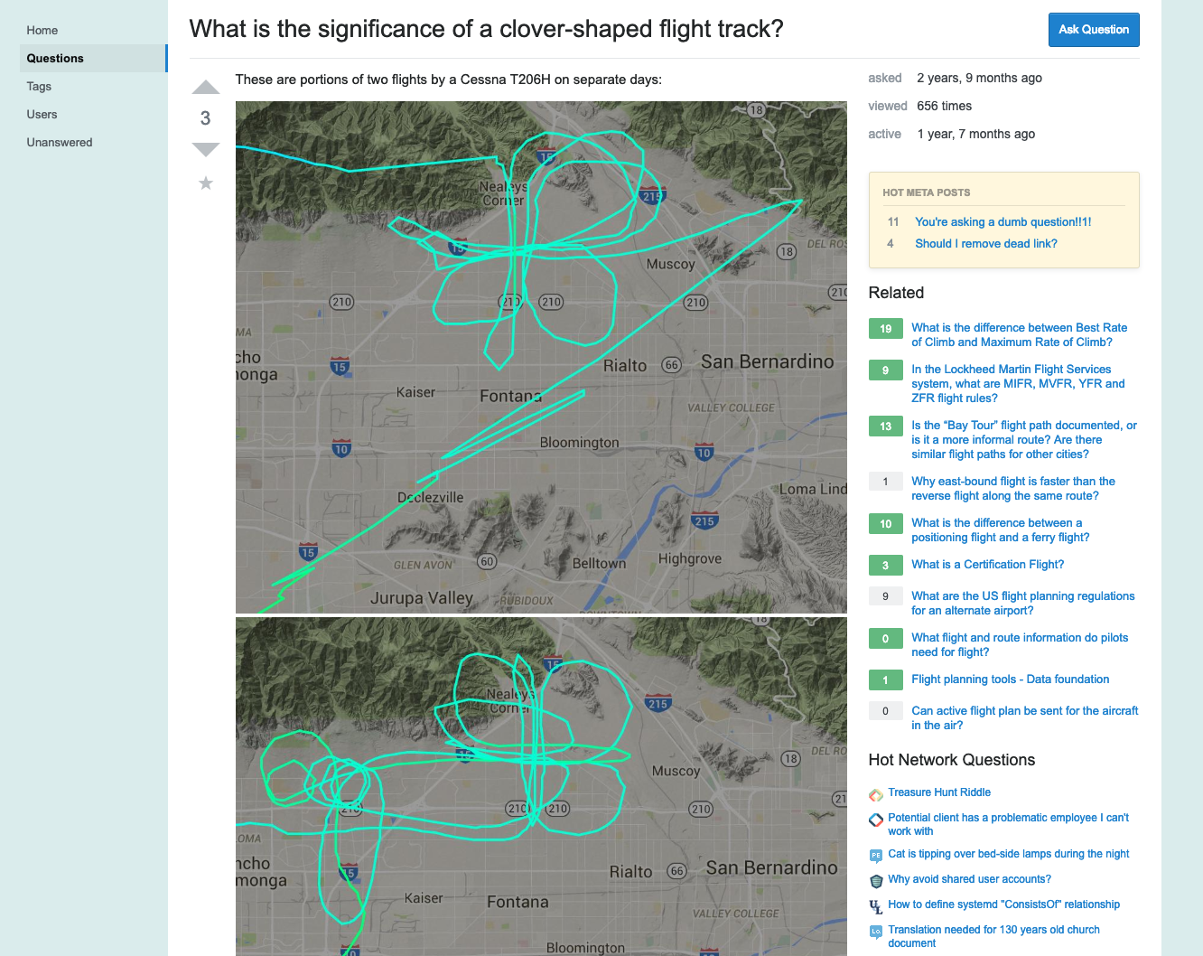
Notes:
I asked on aviation.stackexchange.com but there wasn’t a conclusive answer. I’ve wondered if it was related to doing radio direction finding.

Slide 34
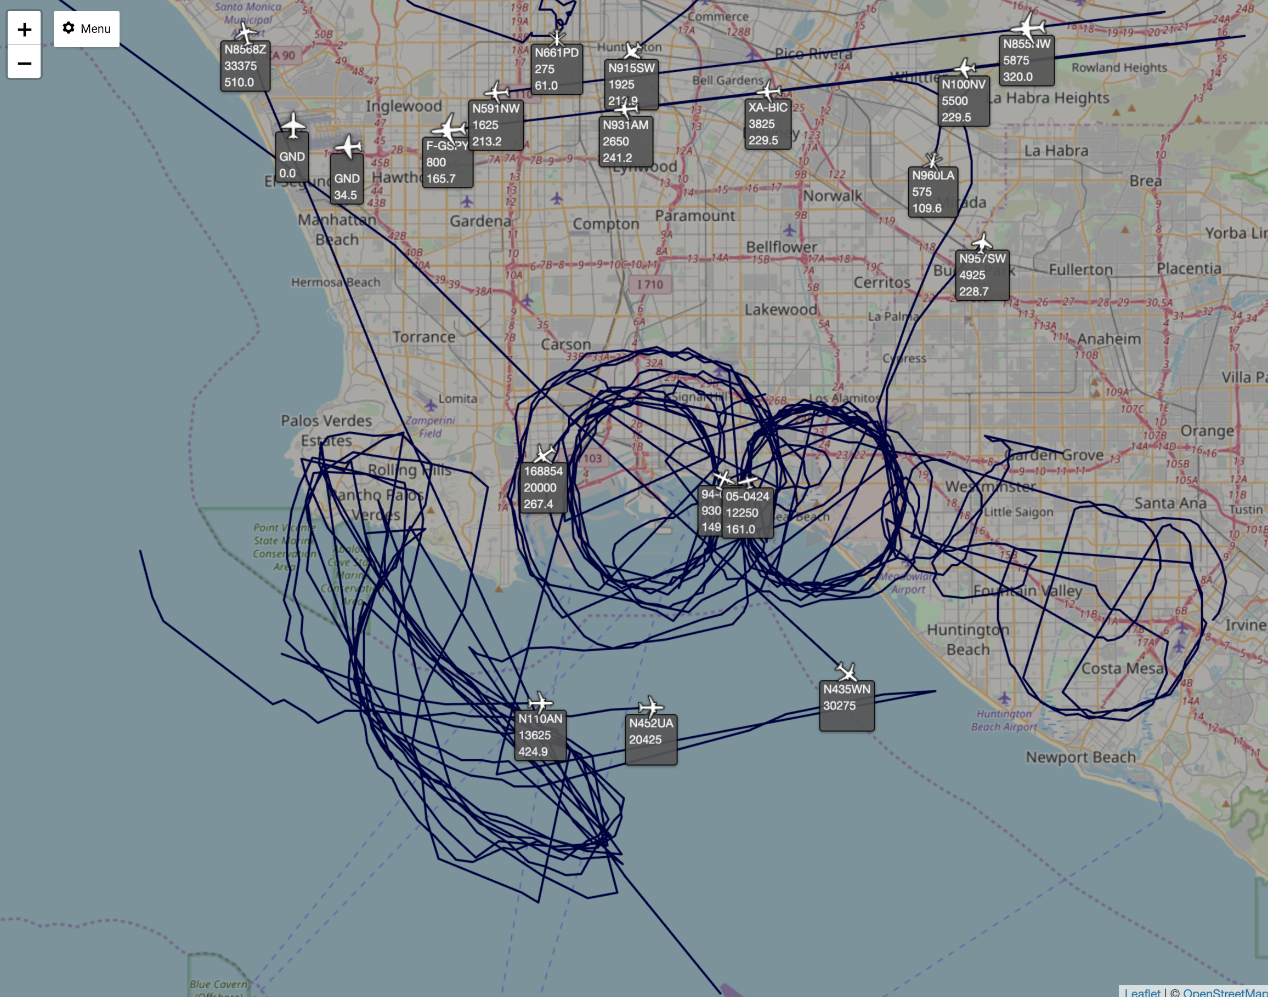
3x military surveillance training
Notes:
A few weeks ago local news showed special operations soldiers training in the LA area, helicopters dropping soldiers on top of buildings etc. They were supported by multiple military surveillance aircraft.

Slide 35
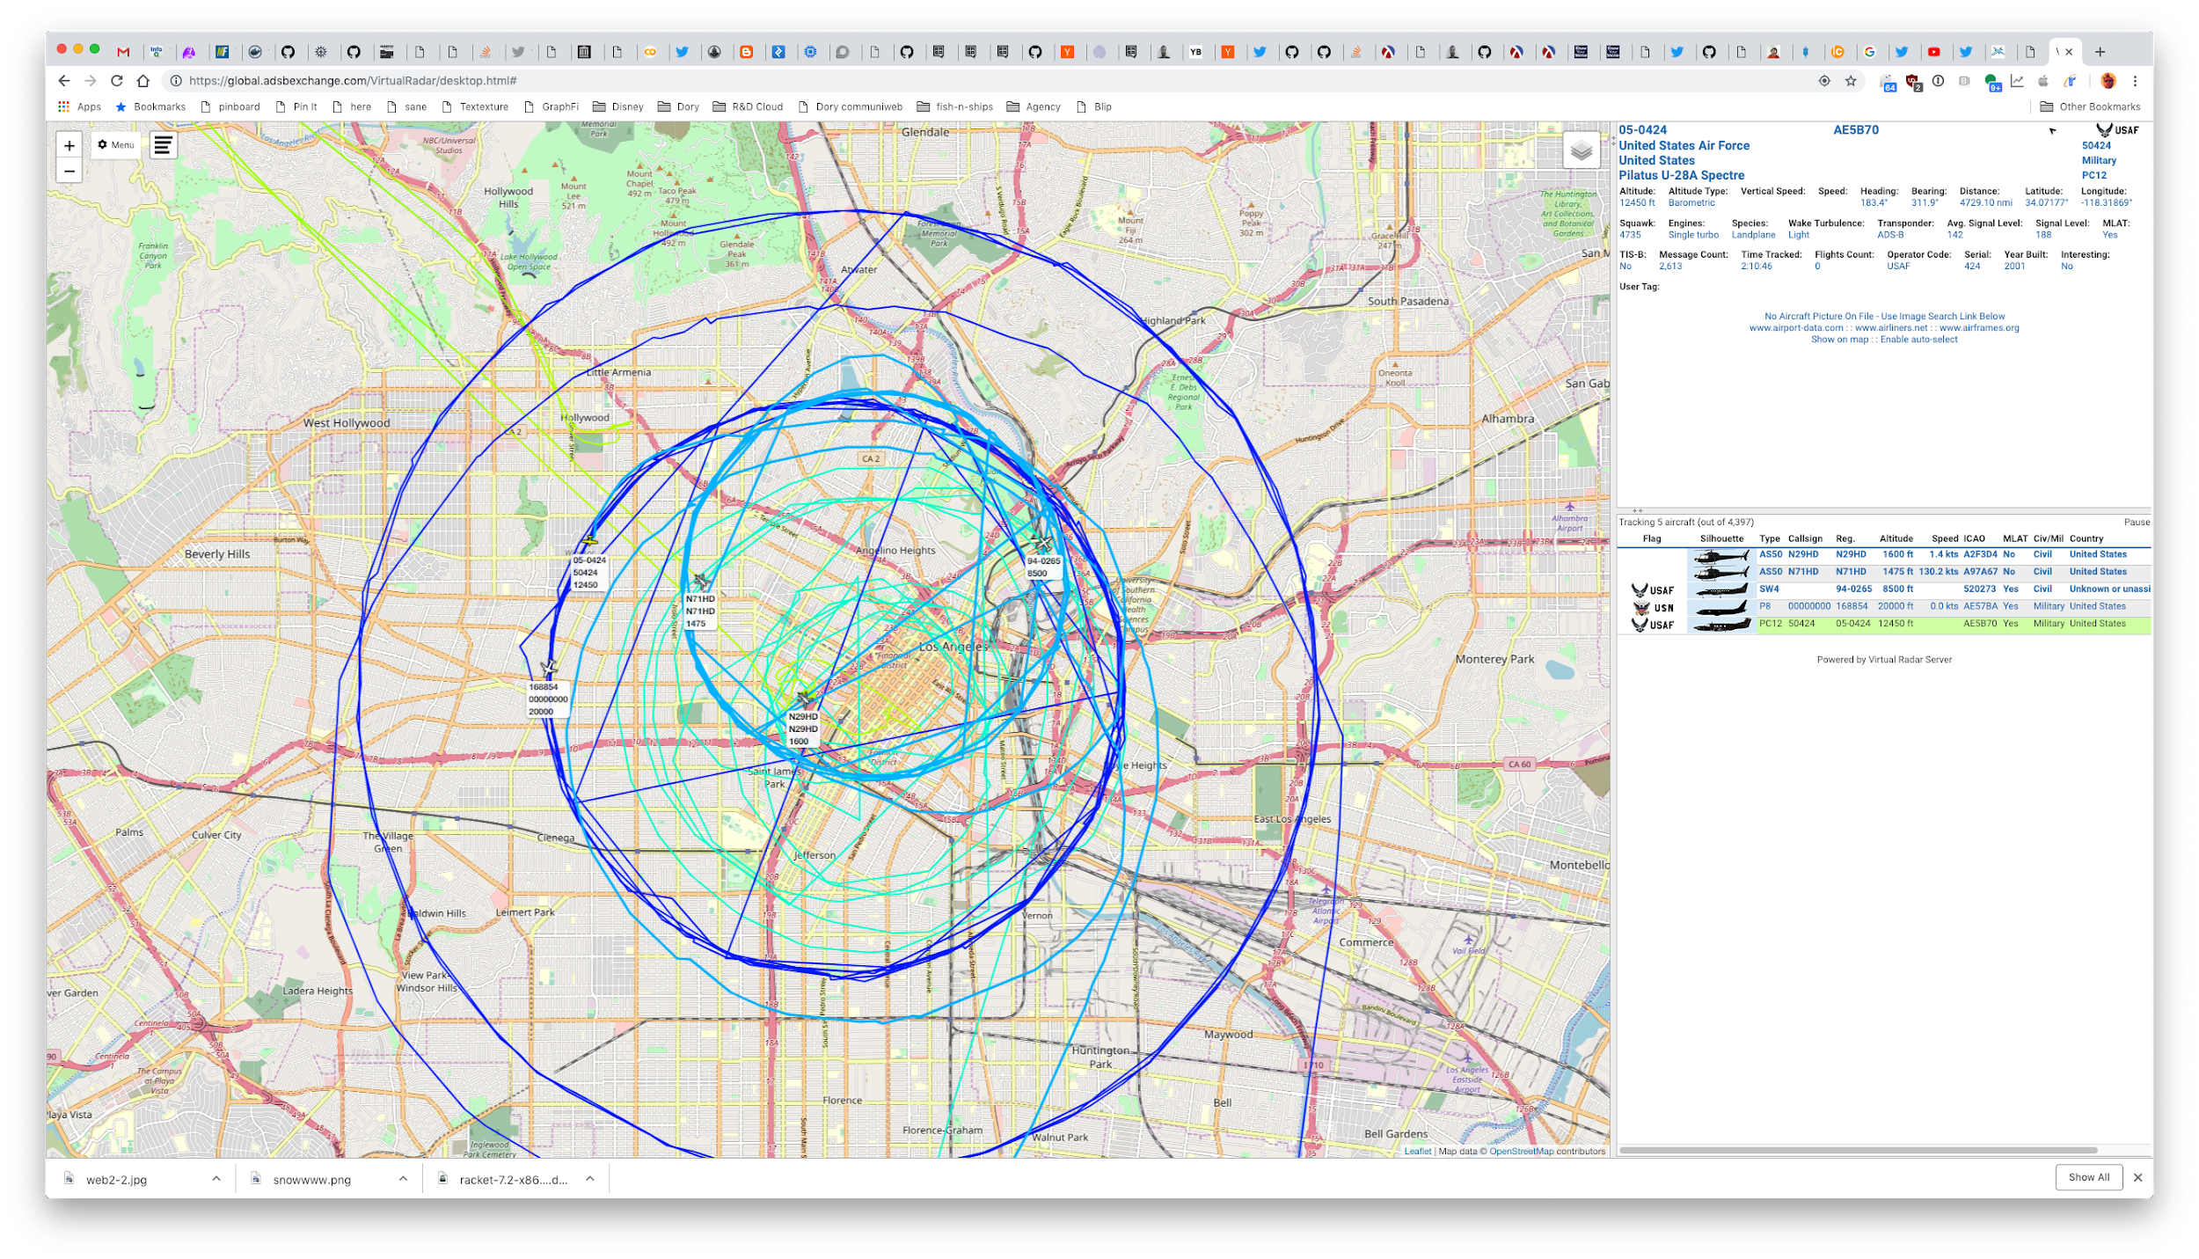
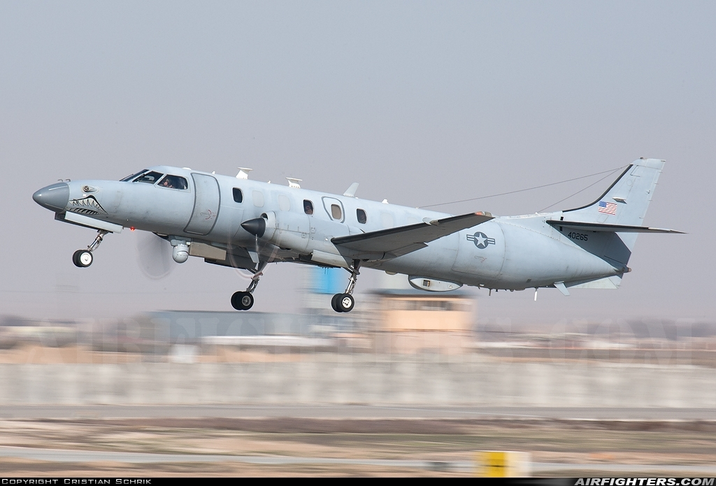
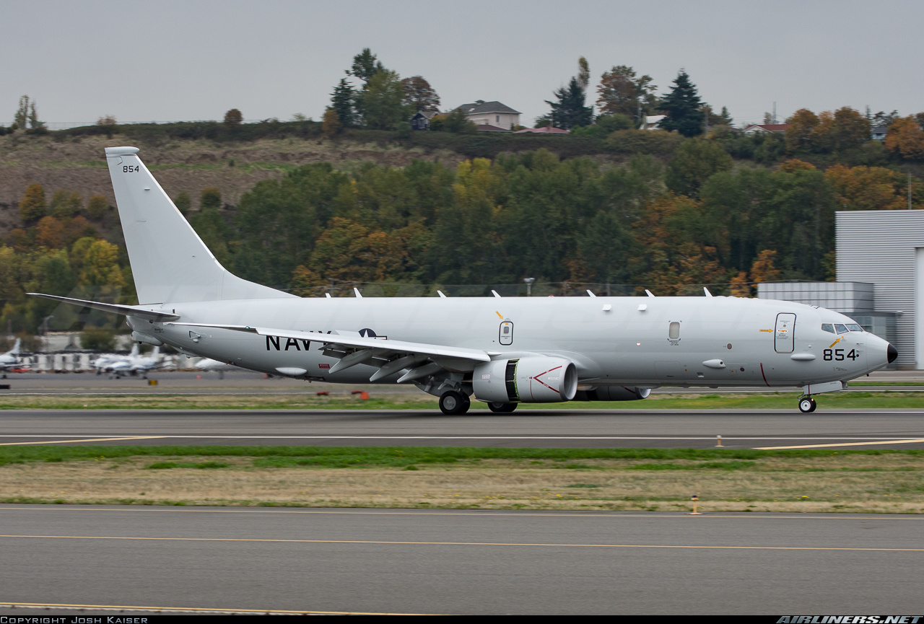
3x military surveillance training
Notes:
And here they are downtown.

Slide 36
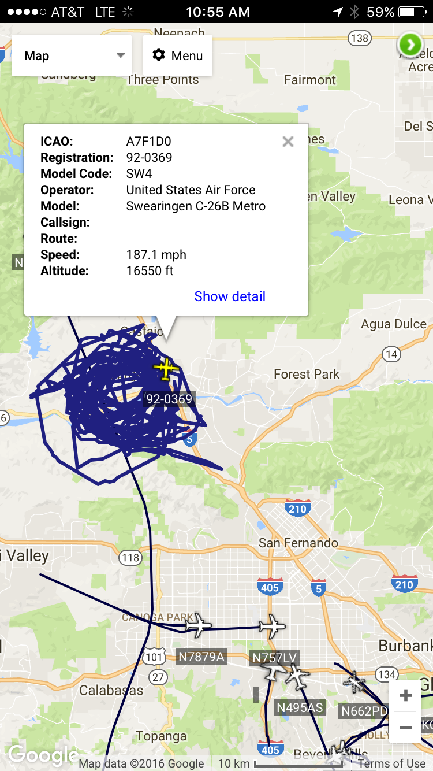
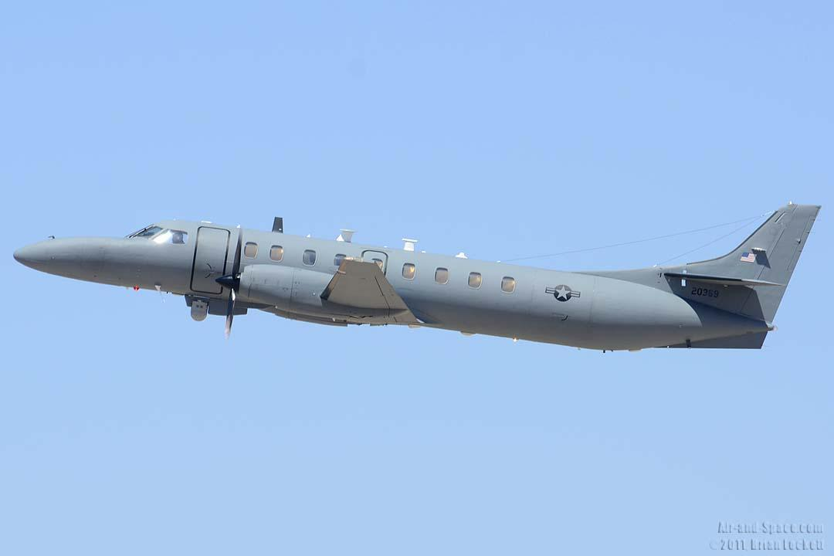
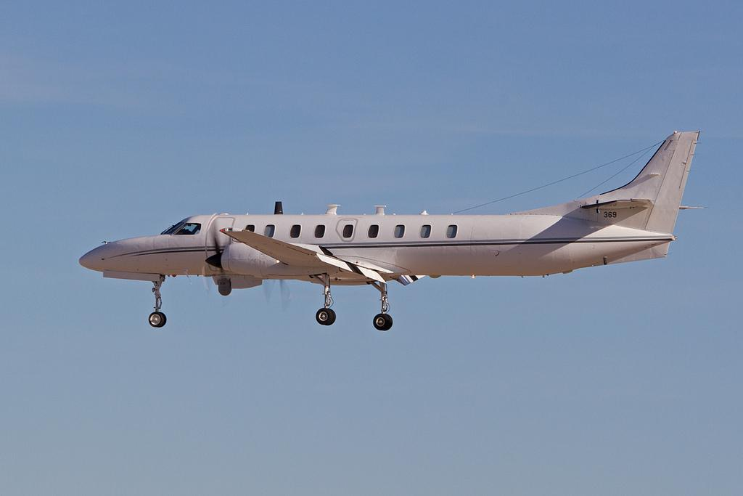
“Air Cerberus”
Notes:
Air Cerberus is a front company used by the military, with an address shared by a National Guard office. Air Cerberus does surveillance over and around LA frequently. They fly planes over the Super Bowl, too.

Slide 37
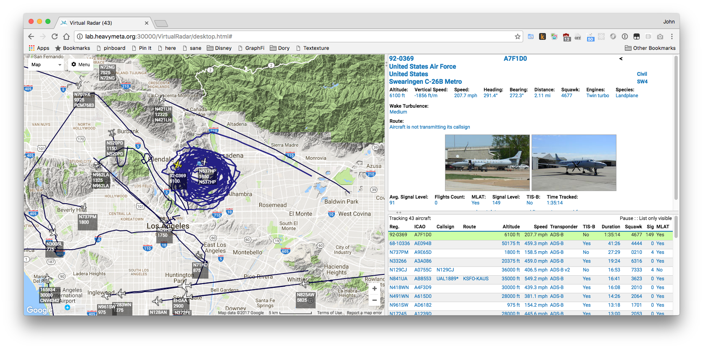
“Air Cerberus”

Slide 38
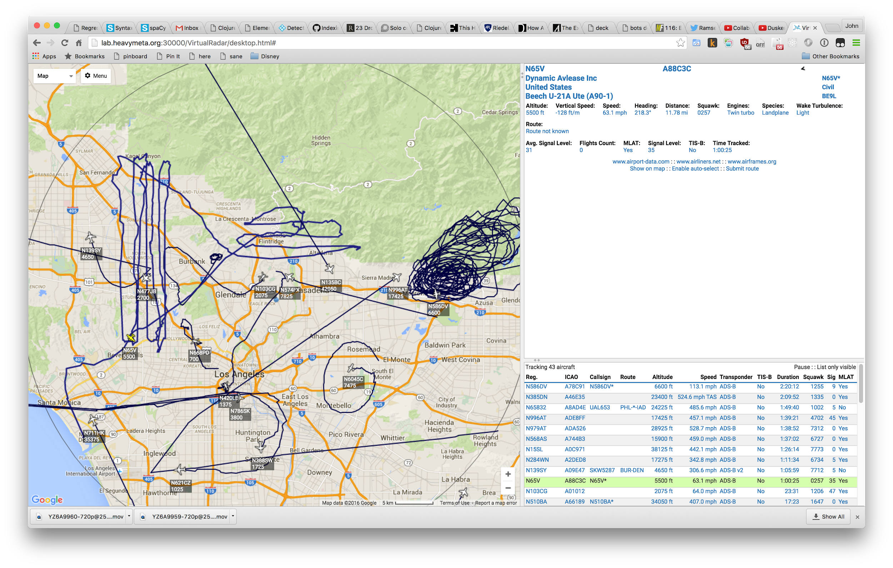
Busy day: SIT, 4 different police departments (N420LE)
Notes:
N420LE is registered to a local drug task force (ha ha).

Slide 39
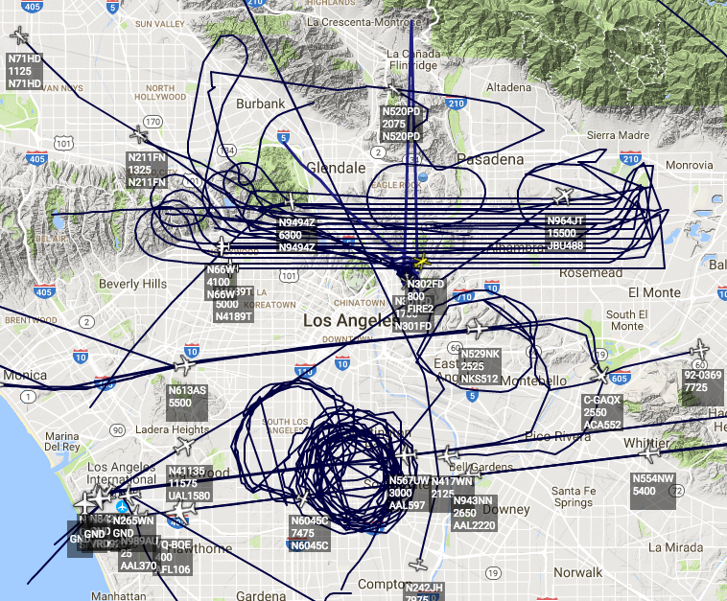
Busy day: 2x news, 2x LAFD, 2x police, SIT, Air Cerberus
Notes:
This isn’t a record of 12 hours of flying or something, this is just an instantaneous snapshot of one moment in time in Los Angeles’ sky.

Slide 40
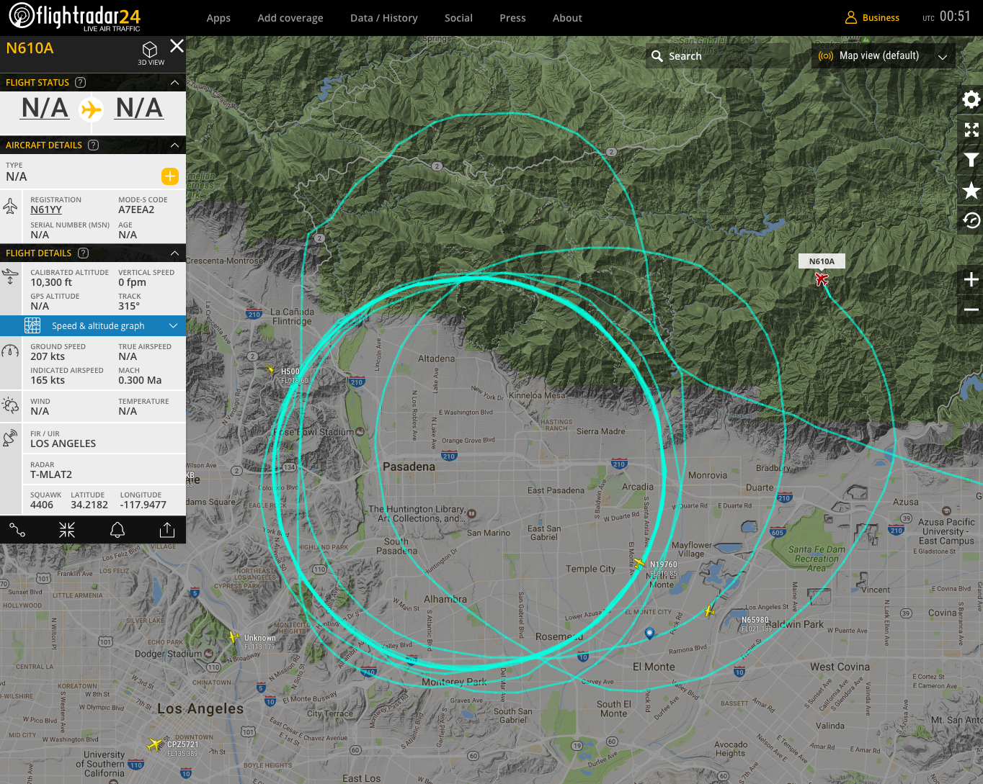
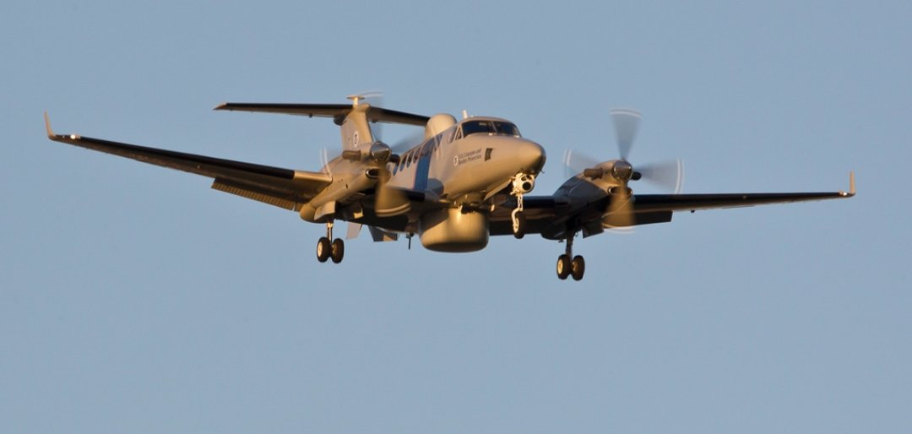
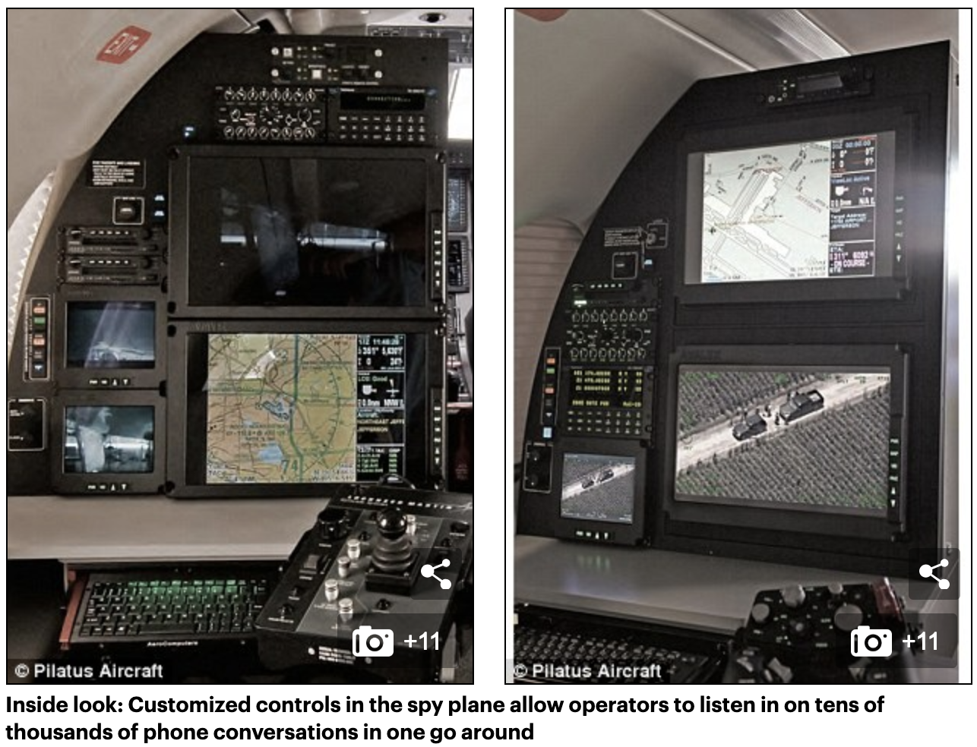
DHS
Notes:
DHS over Pasadena. Check out the equipment pods on that.

Slide 41
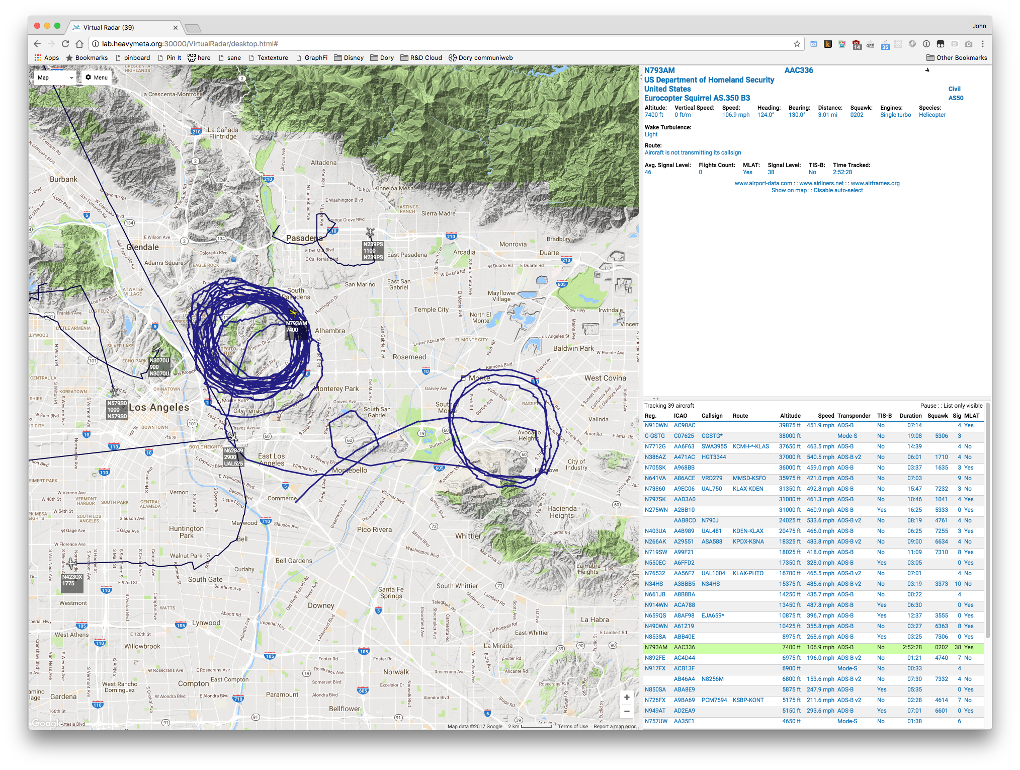
DHS

Slide 42
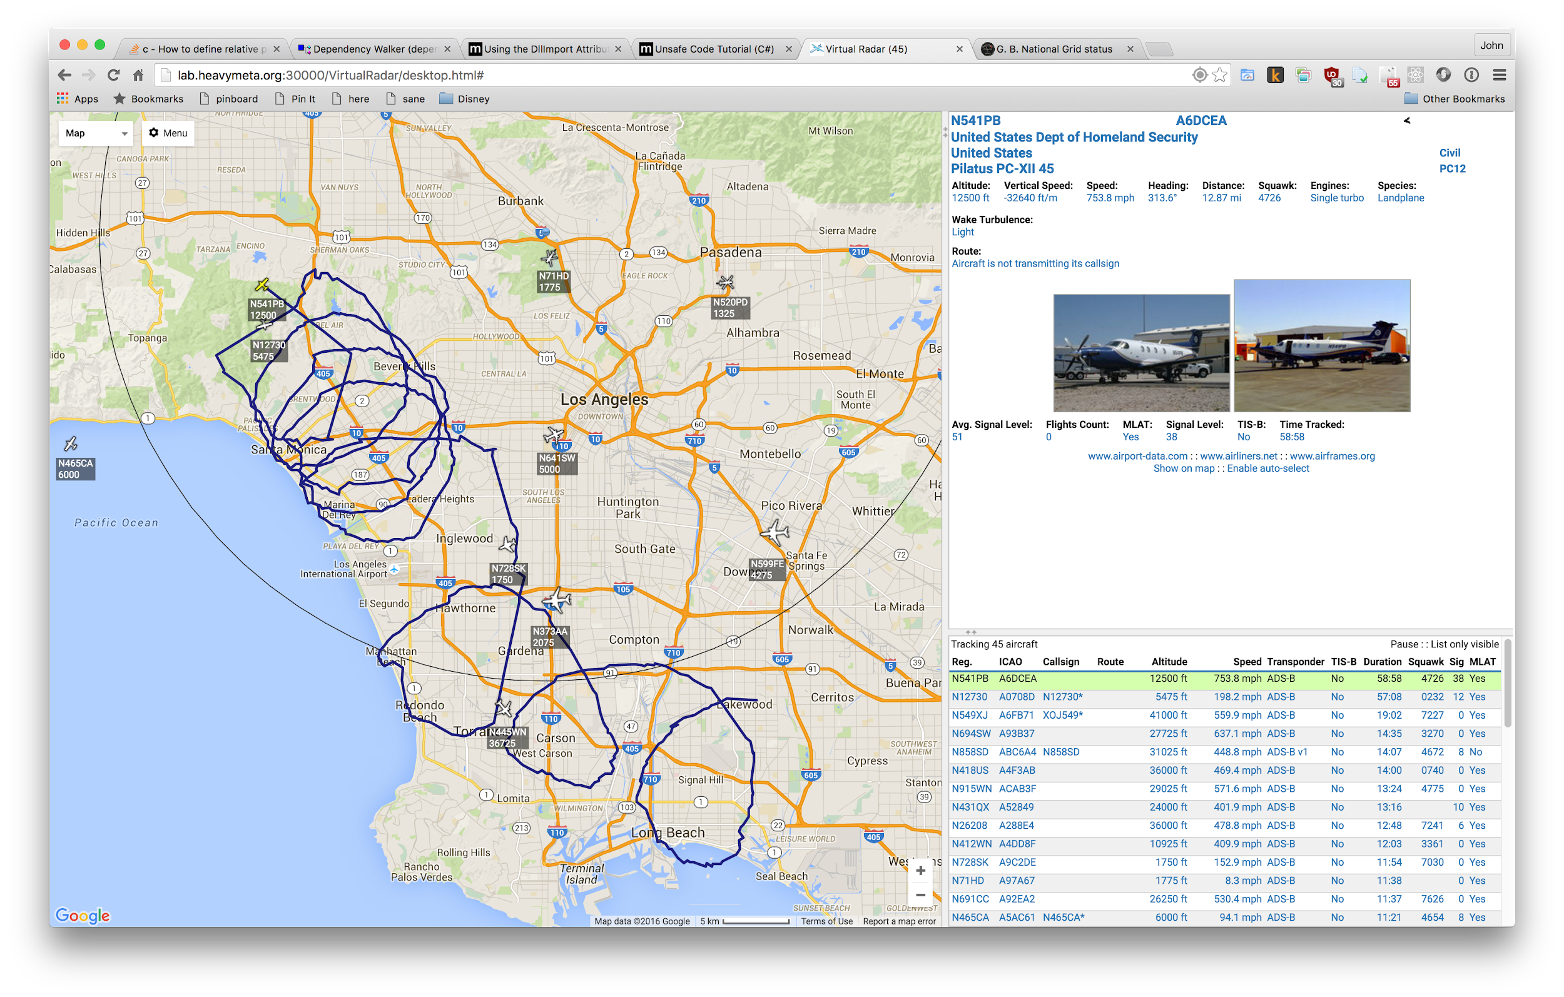
DHS, Subject driving 405 north

Slide 43
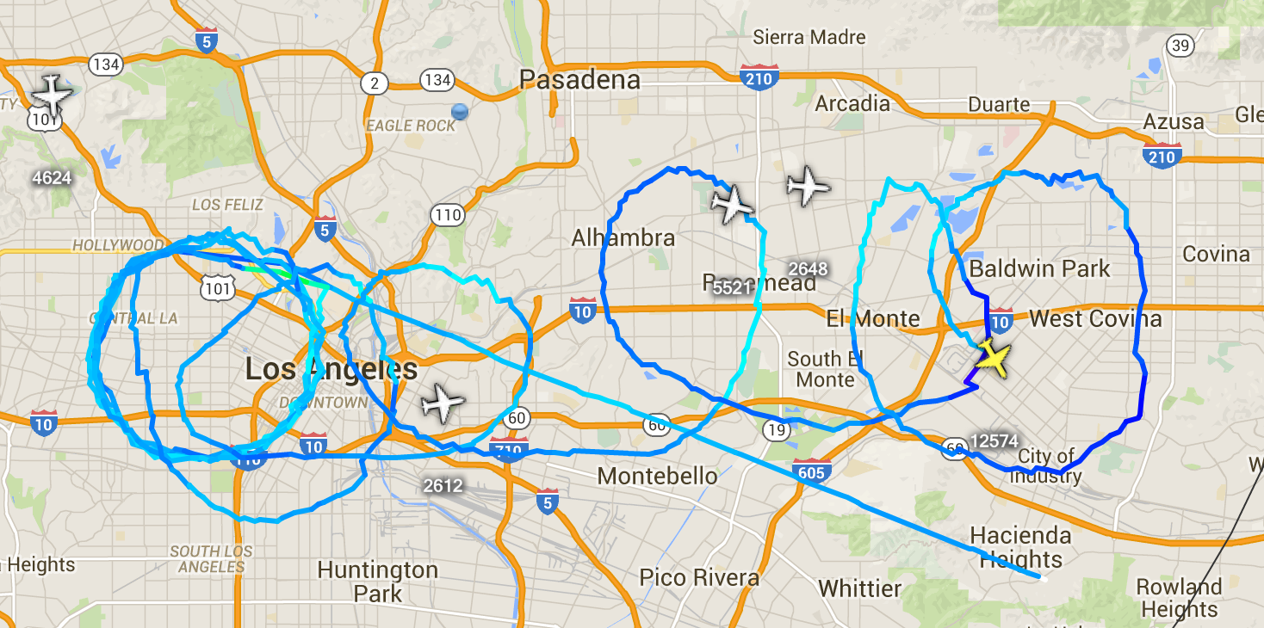
DHS, Subject driving 10 east

Slide 44
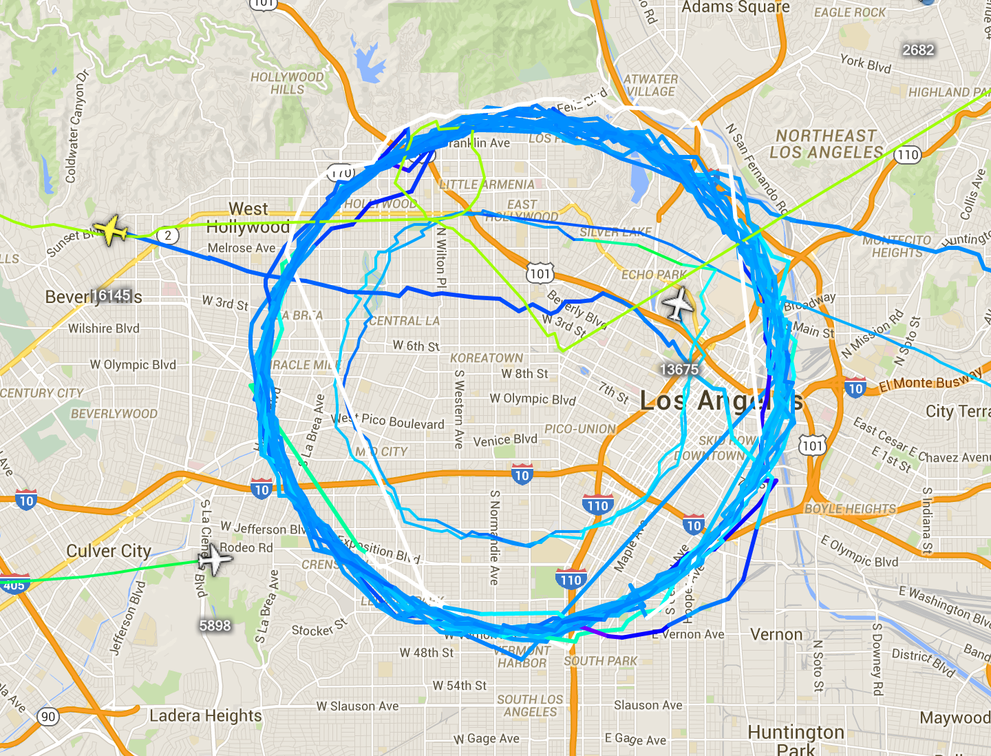
DHS Shift change
Notes:
The aircraft flying the outer circle is leaving, the one flying the inner circle just arrived.

Slide 45


2x Silver Creek Aviation (DEA)
Notes:
In the lower right there’s a Cessna registered to a small Texas company, Silver Creek Aviation. Why is it flying circles over LA? Why does it have a camera turret? Because Silver Creek Aviation is actually a front for the DEA. How do I know? We’ll get to that.

Slide 46
OK, this isn’t really about police helicopters
Notes:
I started out tracking police helicopters, but then something else fell into my lap.

Slide 47

Notes:
In May 2015, The Washington Post published an article about how some planes were circling over Baltimore neighborhoods after the Freddie Gray riots, and how some guy thought for some unknown reason that they were FBI surveillance planes.

Slide 48

Uncovering aerial surveillance by the FBI
...with Unix (& Clojure & postgres)
Notes:
This talk is actually about uncovering a massive, secret, FBI aerial surveillance program.

Slide 49

Notes:
Since tracking aircraft was kind of my thing, and I’m also interested in military and police surveillance, I was curious.

Slide 50

Notes:
The article included one piece of identifying information for one plane: It was owned by NG Research.

Slide 51

Notes:
Googling NG Research led to lots of suspicious (or paranoid) people posting about possible surveillance planes. This redditor thought “NG Research” was Northrop Grumman (it’s not).

Slide 52

Notes:
They mention the tail number, and that the ownership record lists Bristow, VA as the owner’s address. They suspect persistent surveillance, and they mention that the FBI sometimes uses the transponder squawk code 4415 when doing surveillance. It seemed a little hard to believe, but I found several people (mostly on conspiracy and/or gun rights web forums) claiming that the FBI used specific transponder codes, either 4414 or 4415, when doing surveillance.

Slide 53
Persistent sousveillance
Using historical sensor data to retroactively identify and track new government targets.
Notes:
I realized I could use my database of transponder pings to do persistent sousveillance! My definition of sousveillance: They’re flying around looking down on us, but I’m looking up at them.

Slide 54

Notes:
I have 7 billion raw transponder pings from about the past 3 years in a postgres database.

Slide 55

Notes:
This is some of the code that ingests messages into the database. It’s clojure, because I like Lisp.

Slide 56

Notes:
This is a neat little DSL for defining an SQL interface for a clojure program. It parses the metadata in the SQL comments and creates clojure functions to do queries and updates using the parameterized SQL.

Slide 57

Notes:
When this screenshot was taken, I was receiving and ingesting about 300-350 messages/second.

Slide 58
What info do I have?
Presence, not position.
Speed, altitude, transponder squawk code
But the internet.
Notes:
I had some information from direct observation using the RTL-SDR dongle to pick up aircraft transponders, and that was enough to leverage a lot of information that was publicly available on the internet, like FAA registration records. When I was doing this, amateur multilateration (“triangulation”) networks didn’t exist, so I didn’t yet have position info.

Slide 59

Starting to get weird: Two companies w/ PO boxes in Bristow VA? Seeing this output was the precise moment I began to think I might have stumbled on to something big.
Notes:
I downloaded a copy of the FAA records and looked up the 8 aircraft that had squawked 4414. Seeing the output of this shell command is the precise point where I began to think it was possible that the paranoid fringe of the internet might be right about something.

Slide 60

N301A - Worldwide Aircraft Leasing Corp.
Notes:
Also available on the internet are photos of almost every aircraft. Obsessive planespotters go around taking pictures, then post them and tag them with the tail numbers. I was able to find pictures of 4 of the 8 aircraft of interest.

Slide 61

N404KR - OBR Leasing

Slide 62

N496WW - National Aircraft Leasing Corp.
Notes:
This one seems to have a camera turret...

Slide 63

N515JW - Aerographics Inc.
Notes:
So does this one.

Slide 64

Notes:
I searched the FAA records for every aircraft registered to a PO box in Bristow, VA, and the results were creepy: Most of these names fit the same simple pattern! These are totally front companies! This is like Trevor Paglen tracking down CIA fronts that own the planes involved in rendition flights--Did I discover an FBI program or a CIA program?!

Slide 65

Really?
Notes:
Closer examination shows that whoever set up these front companies was kind of sloppy. Besides the repetitive naming pattern, they used the same PO box for a few companies--and that PO box is also used by the Department of Justice.

Slide 66
I was able to expand the list from the 8 aircraft I had directly observed to 105 (suspected) aircraft, almost 2 dozen (suspected) front companies.
Notes:
Using similar techniques and more analysis of the FAA records, I was able to come up with a larger list.

Slide 67

Notes:
I compiled and published a spreadsheet containing a list of over 100 suspected FBI aircraft and almost 2 dozen suspected front companies.

Slide 68
Definitely weird
Evidence all pretty circumstantial:
Squawk 4414
Names like “ABC Aviation”
PO boxes in Virginia
Notes:
But I didn’t have hard evidence. There was no real proof of links to the FBI. Even the FAA records could just be wrong: Government databases sometimes have errors.

Slide 69
Large scale aerial program?
More than 100 aircraft, almost 2 dozen front companies, over lots of even medium-sized cities.
Notes:
I was hypothesizing the existence of a pretty big secret program.

Slide 70
Large scale aerial program?
Lots of local news stories about people complaining about mysterious Cessnas circling overhead.
Obviously mentally ill people with videos on YouTube about these specific planes!
Notes:
I wasn’t sure what to do with what I had so far. I spent more time idly Googling.

Slide 71
Large scale aerial program?
Did I fall into the same paranoid trap as the people on the fringe web forums I’ve been reading?
Notes:
I wasn’t sure what to do. I contacted the ACLU asking if they’d be interested in possible evidence of a secret aerial surveillance program, but didn’t follow through.

Slide 72

Notes:
I posted a short description of my findings to Hacker News.

Slide 73
Then two things happened:

Slide 74
1. A few days after initial WaPo story, FBI admitted “NG Research” was them!
Notes:
This was the first piece of hard evidence connecting my list of 100 suspected front companies to the FBI. It was an exciting day.

Slide 75
2. 4 weeks later, AP broke the story of > 50 planes & front companies!
Notes:
The Associated Press did actual, impressive journalism. They didn’t find as many planes, but they were probably using a higher standard of evidence than I was.

Slide 76


Slide 77



Slide 78

Notes:
This is a frame of video from one of the planes watching the riots in Baltimore, the planes that started this. You can find the whole video on YouTube.

Slide 79
Large scale aerial program
Not totally unknown: Knew FBI was using small planes for aerial surveillance.
Not known viscerally: Huge scale of the program.
Notes:
In researching this I found articles from years ago about the FBI using Cessnas for surveillance. We knew it was happening, but I think that people didn’t understand that it meant multiple planes over every medium size or small city in the country, for hours every day. I think seeing flightradar24 screenshots of circular tracks over their cities got people interested, and it got Congress interested.

Slide 80
What are they doing?
video surveillance
IMSI catching/StingRay
Persistent video surveillance?
Notes:
Surveillance during an investigation is the FBI’s job. But some of what I observed didn’t necessarily fit that model.

Slide 81

How often is N404KR overhead?
Notes:
For example, N404KR is an FBI plane that flies over Los Angeles a lot. Roughly every other day, for hours at a time, for months. What is it doing?

Slide 82
Checklist of suspicious plane behavior
Tail number or registered owner is on one of the published lists
Squawks 4414 or 4415, or has a callsign “JENA” or “JENNA”
Loiters for hours at around 5000 feet
Flies in circles
Owner in Bristow VA, Greenville DE, Wilmington DE, or Manassas VA
Notes:
If you’re wondering if a particular plane is actually an FBI surveillance plane, here are some things to check. You can observe some of these things directly with an RTL-SDR, or use Flightradar24, or use FAA records.

Slide 83

Notes:
Here’s some code I wrote to find tracks that have lots of circles.

Slide 84

Notes:
And here’s a few months worth of orbits it detected, minus some of the known LAPD etc. aircraft. I love the aircraft following someone the whole way along Sunset Blvd (that’s actually a helicopter following the LA Marathon).

Slide 85


Notes:
Some reporters at Buzzfeed News have done some excellent, technical investigation. Note that the most important property for determining whether an aircraft does surveillance is… whether it flies in a counterclockwise circle (“steer2”). Second most significant is the squawk code.

Slide 86

The FBI issued a rare public statement on their aviation program.

Slide 87


Slide 88
Summary
This wasn’t hard: All I had to do was look.
I used publically available data: transponder pings, planespotter photos, and FAA records.
The paranoid were right this time.
Multiple people were motivated to independently make this discovery.
This is not news: articles as far back as 2003; possibly a surge in 2013.
Behavior suggestive of persistent surveillance, not targeted investigation.
Potential for more citizen investigation.

Slide 89
Next steps
More automated analysis, à la Buzzfeed News
Shadow surveillance aircraft (without interfering)

Slide 90

Automatic telescopic observation

Slide 91

Opportunistic use of existing public webcams

Slide 92
Links
Baltimore FBI aerial surveillance video
“Tracking planes with RTL-SDR” intro from MAKE
“How you can track the FBI’s spy planes”
Planes over LA.2 map
Police helicopter KML
orbital detector notebook
“Cheap ADS-B on amateur drones”
“Augmented reality display of air traffic for amateur drones”
List of aircraft & front companies
ADS-B Exchange (the only uncensored multilateration network, run by amateurs)
Web interface to my receiver
My github (DB ingestion, analysis)
@lemonodor twitter

